Slide 1
阅读练习讲解

Slide 2
Will room-renters be subject to hotel taxes, for example?
Prices may be subject to alteration.
All nuclear installations are subject to international safeguards.
The proposal was firmly rejected .
Please reject the following candidates.
She is officially registered (as) disabled.
A

Slide 3
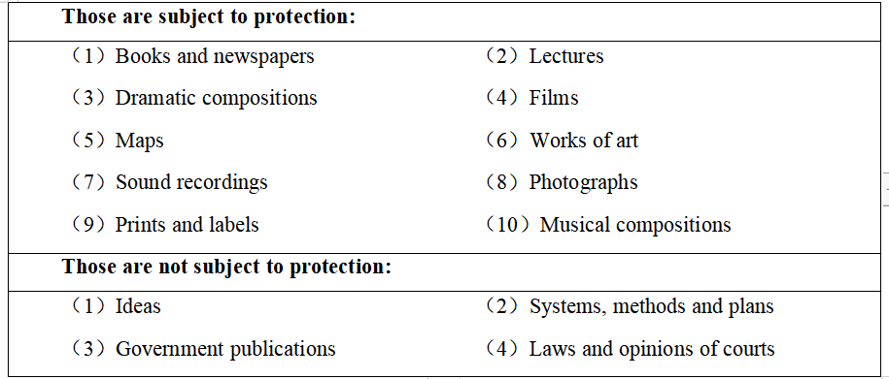
The Copyright Office will provide on request a variety of leaflets （小册子） describing the procedure and giving information about the classes of subject matter that can be registered.
23. According to the text, the Copyright Office may reject ____.
A

Slide 4
1.Ernest Owusu was 13 in 1980 when he was given the opportunity to appear in the audience of a BBC show, and ask Thatcher how she felt about being called the Iron Lady. This encounter re-emerged in a BBC's programme recently.
What does the encounter refer to?
Find out more “meeting”s mentioned in the following passage.
Owusu’s meeting with Thatcher
Owusu’s asking questions and Thatcher’s answer at their meeting
2.At the time of their meeting....
4......And he says it began by asking the woman herself. "To this day it still has an impact......
5......Owusu recalls the moment, "I just remember her eye contact. She was answering me, not the camera. She welcomed the question saying you've got to be firm in this world. And that stuck with me. "
6........It was one of those key moments to make you do things maybe you wouldn't otherwise have done. "
What do these underlined words and phrases refer to?
B
No. 26 27

Slide 5
3.Now 57, Owusu looks remarkably similar even with a greying beard. But his life has been transformed. The father of three is a human resources director, and the first black captain of the Addington golf club in its 110-year history. As a black guy, it is about breaking the glass ceiling.
How do you understand the underlined part?
When people refer to a glass ceiling, they are talking about the attitudes and traditions in a society that prevent women or the colored from rising to the top jobs.
B

Slide 6
Read paragraph one and answer:
What is the pressure farmland is facing now?
It has to produce more food and clean energy.
Since the last ice age, humans have cleared nearly half of the earth's forests and grasslands for agriculture. With the world population expanding, there's ever-increasing pressure on farmland to produce not only more food but also clean energy. In places such as Yakima County, Washington, it's created competition for space as land-hungry solar panels （板） consume available fields. Last month, the state approved plans to cover 1, 700 acres of agricultural land with solar panels, fueling concerns over the long-term impacts of losing cropland.
How do you understand “land-hungry?
C

Slide 7
30. What do we know about the organic solar cells?
3.A goal of the study is to create a new generation of solar panels. He sees potential in the organic solar cells, which come from carbon-based materials. Thin and transparent, the cells are applied like a film onto various surfaces. This new technology could be used to develop special solar panels that block blue light to generate power, while passing the red light on to crops planted directly below. These panels could also provide shade for heat-sensitive fruits during the hottest part of the day.
What is the feature of solar cells?
What are the functions of solar cells?
C

Slide 8
31. What does Abou Najm think of the future of the new solar panels?
1.By 2050, we'll have two billion more people, and we'll need more food and more energy. By maximizing the solar spectrum, "we're making full use of an endlessly sustainable resource, "says Abou Najm. "If a technology kicks in that can develop these panels, then the sky is the limit on how efficient we can be. "
C

Slide 9
What is “anxiety” commonly believed to be?
What is “anxiety” in the writer’s opinion?
Para 1:
No. 32
"Anxiety. "The very word invites discomfort. Its effects-shortness of breath, pounding heart, muscle tension--are outright upsetting. But, as a clinician, I find that we tend to miss out on many valuable opportunities presented by this human emotion. In and of itself, anxiety is not deadly, nor is it a disease. Quite the contrary: it is an indicator of brain and sensory health. Once we accept that it is a normal, though uncomfortable, part of life, we can use it to help us.
D

Slide 10
What is the feature of “a good physical workout”?
33.Why does the author mention "good workout" in paragraph 2?(写作手法）
Para 2:
We all know working out at the gym is hard. By nature, a "good workout" is uncomfortable, since it involves pushing our physical strength past what we can easily do. The sweet spot of exercise is always a somewhat challenging experience. Similarly, if you want to be emotionally stronger, you need to face some tension. For example, one effective treatment for fear is exposure therapy （疗法）， which involves gradually encountering things that make one anxious, reducing fear over time.
A good physical workout can build physical strength.
build mental strength
A good mental workout can __________________.
D

Slide 11
What is expert Sue mentioned?
What is the writer’s opinion?
Para 3:
To prove the witer’s opinion.
3. Humans are social creatures. When my patients learn to open up to their partners about their anxieties, they almost always report a greater sense of emotional closeness. Also, as international relationship expert Sue Johnson teaches, when we express our need for connection during challenging moments （e. g. , "I'm having a hard time right now and could really use your support"）, it creates greater connection and turns our anxiety into love.
D

Slide 12
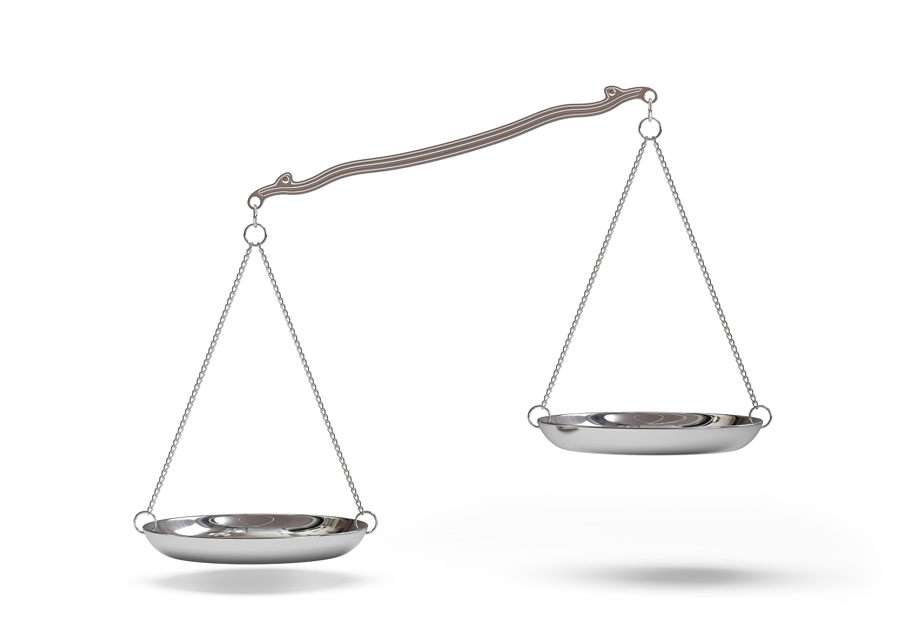
4.From time to time, we find ourselves at the end of our rope. Our responsibilities pile up, our resources break down, and we feel uncomfortably anxious-what we're experiencing is called stress. Simply put, the demands placed upon us outweigh our available resources, just like a set of scales （天平） going out of balance. Focusing on work and pretending everything is OK only leads to disastrous results. Medical treatment for stress may function for a while, but it tends to make things worse in the long run. The only solution to deal with stress is to do the mathematics to balance the scales.
What are on the ends of a scale?
What is the function of “simply put”?
to restate the situation
resources
No. 35
demands
D

Slide 13
Cloze test

Slide 14
Katherine would never forget the day when her daughter brought a plate from kindergarten, with a drawing of mouse-like creatures on it. "Emma, what are these little characters? What do. You 41 them?" Katherine said. "Mom, they're my 42 . They come to children who are lonely or who were meant to have a 43 life, "Emma said. It 44 the unemployed 36-year-old mom's heart during a time when she wasn't feeling too good about her job 45 .All this eventually 46 a new project for Katherine, unemployed for months--making a line of stuffed animals. for sale based on her daughter's 47 . "Every day, I would work on it, " she said. "Over time, it felt like this is what I really 48 . "In her basement, Katherine cut patterns, wrote storylines and 49 prototypes（原型样品） to turn "The Representatives" into dolls（玩偶）.Today she has four 50 doll prototypes and specific storylines to go with each main character. She hopes to 51 the dolls to parents going through hard times, or maybe those preparing to work overseas, leaving their 52 behind with relatives. She said even if the dolls don't 53 , she's taught her daughter 54 to keep moving even in down times. It's really a 55 for those unemployed right now, she said.

Slide 15
Who?
What situation?
Katherine and her daughter Emma
Katherine was _______ and was not sure about her future.

Slide 16
Katherine would never forget the day when her daughter brought a plate from kindergarten, with a drawing of mouse-like creatures on it.
All this eventually 46 a new project for Katherine, unemployed for months--making a line of stuffed animals. for sale based on her daughter's 47 .
"Emma, what are these little characters? What do. You 41 them?" Katherine said. "Mom, they're my 42 .
In her basement, Katherine cut patterns, wrote storylines and 49 prototypes（原型样品） to turn "The Representatives" into dolls（玩偶）.

