Slide 1
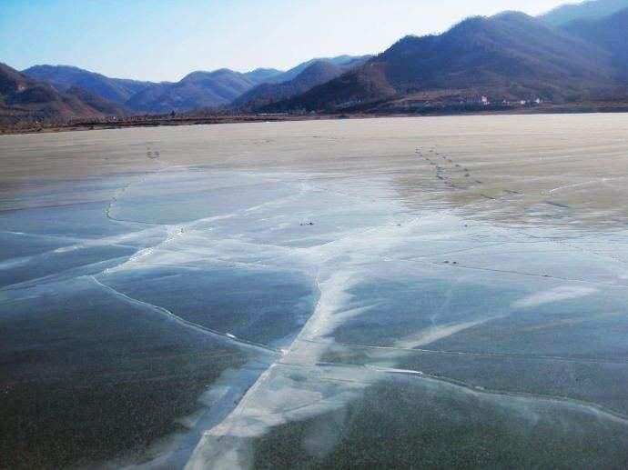

Slide 2
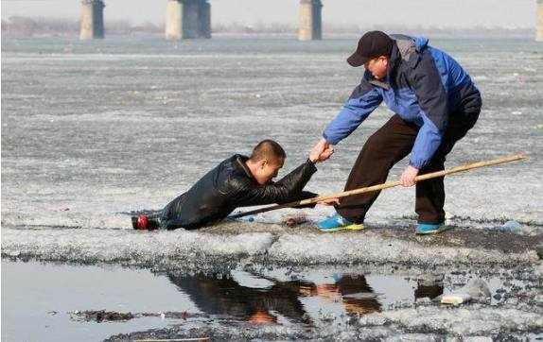

Slide 3
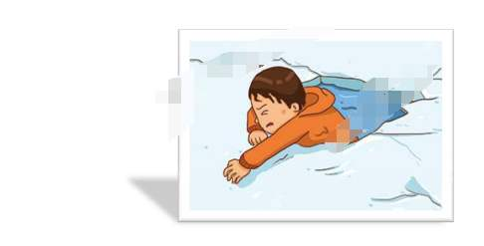
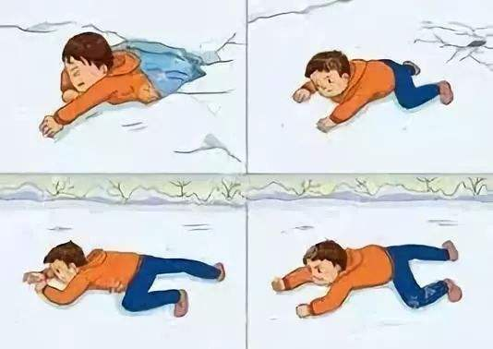
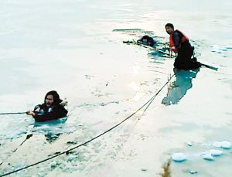
Through the ice

Slide 4
Reading for basic informantion
when
where
why
A story
who
how
what

Slide 5
Reading for basic informantion
brothers
I
Harry
contrast
In summer
In winter
sometime smelly有臭味的
a pond
an inviting place
lay behind
our farm

Slide 6
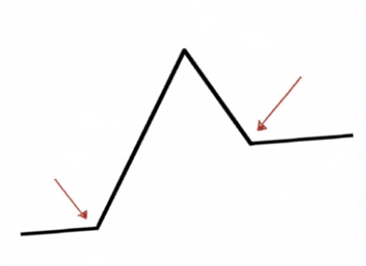
Reading for plot
Events
A. The pond was so inviting in winter that I decided to slide across it at the instigation鼓动 of my brother.
B. I struggled to climb out of the icy water by myself, but in vain.
C. With the ice cracking破裂, I fell into a hole in the ice.
The pond behind our farm was not suitable for swimming in the summer.
Harry turned and ran from the pond…
E
Climax
C,B
Rising action
Inciting incident
A
Setting背景
D

Slide 7
Changes of feelings
Time | Events | feelings
1. Before I slid across the pond | Harry _____ me to go first because of my lighter weight. In order to ______him and have fun, I ______. | I felt _________ but_______.
2. When I was in the middle of the pond | With ice ________ suddenly, I fell into a hole. Arms ___________ on the ice and body ________in the icy water, I was ___________ in the hole. | I got _________ and ________.
3. When I tried to save by myself | I attempted to climb out of the icy hole several times but ______. The heavy coat, _____________________________________worsened the terrible situation. | I was __________ and _________.
4. When I looked at Harry | Harry was ________________. I _________ at him for ________. | I was ________ but __________.
urged
hesitant
please
取悦
willing
agreed
cracking
outstretched
shocked
hanging
trapped
/caught
scared
in vain
exhausted
becoming wet completely and dragging me down
nervous
What did Harry do?
rooted to the spot
anxious
screamed his help
hopeful

Slide 8
Reading for plot
Falling action
Resolution解决
Ending

Slide 9
Predicting the development
Predict the development from the given sentences
Paragraph 1:
Harry turned and ran from the pond.
Paragraph 2:
The moment I crashed through the kitchen door, sobbing, mum rushed over.
I was rescued.

Slide 10
Predicting the development
Raise questions about the development
Paragraph 1:
Harry turned and ran from the pond.
1. What was my response to his leaving?
I was rescued.
2. Did he really leave me alone?
3. How was I rescued?

Slide 11
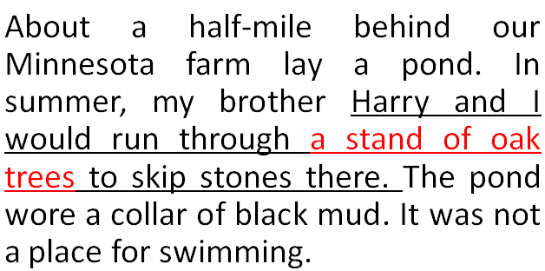
Predicting the development
Paragraph 1: Harry turned and ran from the pond.
1 What was my response to his leaving?
2 Did he really leave me alone?
3 How was I rescued?
shocked; disappointed; despair(绝望)/desperate
wonder
an oak branch(橡树枝)
原文素材

Slide 12
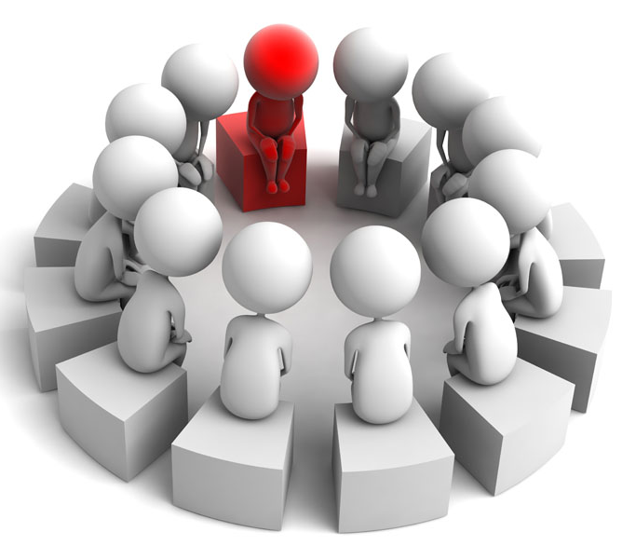
Predicting the development
Paragraph 2:
The moment I crashed through the kitchen door, sobbing, mum rushed over.
Discussion
MUM
I
Harry
What will happened?
Think about some questions.

Slide 13
Predicting the development
1 As soon as I came back home, what was mum’s first reaction?
She had to deal with my wet clothes and make me feel warm.
take a shower
take off my clothes
How?
fireplace(壁炉)
hot drinks(milk)

Slide 14
Predicting the development
1. As soon as I came back home, what was mum’s first reaction?
Taking off my clothes from me. she gave me a bath and then quickly wrapped a thick blanket over me to stop me from feeling cold; meanwhile she gave me a cup of milk to warm me up.

Slide 15
Predicting the development
MUM
I
Harry
2. What was mum’s following reaction to our stupid behavior?
scold
apologize
3. Did Harry say something to me?
4. What lesson did I learn from the experience?

Slide 16
Predicting the development
4. What lesson did I learn from the experience?
Always stay away from potential risks and bear in mind that curiosity kills cats. 永远远离潜在的风险，并记住好奇心会杀死猫。
I would never forget the life-risking experience and never act so blindly again. 我永远不会忘记这次危及生命的经历，也不会再盲目地行动了。

Slide 17
Tips for writing
Let “body language” speak!
How to express disappointment失望 / dismay惊愕:
皱眉
“Where could he go?” I murmured(低声抱怨) with a fierce frown.
失望地看
I shot/threw/cast a frustrated look at him.
摇头
I just shook my head in hopelessness.
哭
Tears of grievance (委屈) /ˈɡriːvəns/ came into my eyes with the figure of my brother out of sight.
颤抖
Staring at the familiar figure out of sight, I was trembling with rage(愤怒) and chill(寒冷).

Slide 18
Show more than tell!
Consumed/ Overwhelmed
______________________(吞噬)by a strong sense of nervousness and anxiety, Harry didn’t know what to do, his heart ________________wildly.(跳动)
A flush of frustration _______ (涌动) from the bottom of my heart, I froze with terror, trembling in icy water and hard to breathe.
The thought of being abandoned/deserted by Harry _________(占据) my mind, dismay and despair ___________(积淀) in my heart.
The icy water ________(刺穿) my skin with needle-like chill as I was ______(湿透) to the skin and __________________ (颤抖).
Desperate and exhausted, I was on the verge of________(崩溃). “Harry. Don’t leave me alone.” I _________(呼喊).
As I looked at his back, I_________, “Is he running for help, or is he running way and leaving me alone?”
beating /pounding
surging
occupying
accumulated
pierced
soaked
trembling/shivering
collapse
exclaimed
wondered

Slide 19
Let “action” speak!
How did Harry save me by using an oak branch橡树枝?
push vt. 推动
grab vt. 抓住，攫取
drag vt. 拖，拉，拽，扯
flop vi. 扑通落下
wriggle vi. 蠕动，蜿蜒而行
Flopping
pushed
_________ to his stomach, Harry _______ the branch before him and _________ toward me. When a slender top branch was within reach, I _________ it. Eventually, I was ________ from the icy water.
wriggled
grabbed
dragged

Slide 20
Let “action” speak!
storming
Seeing Harry ________(冲) back to the pond with a long stick in his hand, I was _______(注入) with fresh blood. The next few minutes ____________ his dragging me to the shore inch by inch.
Finally _____Harry with a long rope. “_____(抓住) it.” He ______________ one end of the rope to me. Desperate to escape from the chilly pond, I _______(抓紧) the lifeline tightly and was eventually _____________(拖;拉) up to the shore.
_________(伸出) out my arms, I _____ (抓住)the oak branch with all my strength and ______ (爬)carefully out of the hole inch by inch. I ________(幸存) eventually.
injected
saw/witnessed
见证
扔
came
Grab
threw/cast/ flung
grasped
dragged/pulled
Stretching
seized
crawled
survived

Slide 21
Tips for writing
A story is an accident, which begins with a problem and ends with a solution.
A good story often has a good theme.
A better story “shows more than tells”.
A great story displays details properly.

Slide 22
Writing the story
Paragraph 1:
Harry turned and ran from the pond.__________________________ _______________________________________________________
Paragraph 2:
The moment I crashed through the kitchen door, sobbing, mum rushed over. ______________________________________________________________________________________________________________

Slide 23
Appreciating and reviewing
Perspectives | Criteria | Scores | Self review | Peer review
Plot | Reasonable and creative? | 30
Theme | To the point(切题) or off the point(偏题)? | 30
Expression | Words and sentence patterns | 30
Handwriting | Is it beautiful? | 10

Slide 24
Appreciate a possible version
句型 1：Doing..., 主 + 谓...
doing作状语，逻辑主语与句子的主语一致，构成主动关系；有时可在doing前加before, after, while等; 被动关系，使用过去分词done作状语。
Para. 1
He turned and ran from the pond. Staring at his familiar figure out of sight, I wondered: “Is he running for help, or is he running away?” Disappointment and scare beat me out of breath. The icy water seemed to pierce my skin. I was anxious to climb out by myself, but in vain. Desperate and exhausted, I was nearly about to give up when Harry stormed back with a large and black oak branch, “Grab it.” Flopping to his stomach, he pushed the branch before him and wriggled toward me. Stretching out my arms, I seized the oak branch with all my strength, crawled carefully out of the hole inch by inch and was eventually dragged out of the icy water by Harry. What a narrow escape! Then we stumbled home, with my clothes dripping(滴水)and my overshoes squishing(发出嘎吱声).
句型2：表情感类adj, 主 + 谓... / 主 + 谓...，表情感类adj
情感类形容词状语，说明主语的情感状态，可转化为Feeling adj, 主+谓...。
With的
复合结构

Slide 25
Appreciate a possible version
Para. 2:
I crashed through the kitchen door, sobbing, mum rushed over. Taking off my coat and clothes from me, she gave me a quick bath and then quickly wrapped a thick blanket over me to stop me from feeling cold; meanwhile she gave me a cup of milk to warm me up. I tearfully complained to her about all that had happened. Mum comforted me and blamed Harry for getting his younger brother into such a trouble. With his head drooping, Harry made an apology to me. Without his rescue, I would have died. At the thought of that, I decided to forgive Harry. But I would never forget the life-risking experience and never act so blindly again.
Linking words

Slide 26
Summary
1 Reading for a story
（5W1H→plot &feeling changes）
2 predict the development
3 theme
4 language
5 handwriting
①the two given
sentences
Continuation writing
②raise questions
①“body language” &“action”
② show more than tell

Slide 27
Assignment
Polish up your writing according to what you’ve learnt.
Share your writing with your classmates.
Try to learn from your classmates and meantime give some advice on polishing up their writing.

Slide 28
Thank you!

