Slide 1
B7 U2 grammar and usage
Overview of
Attributive Clause

Slide 2
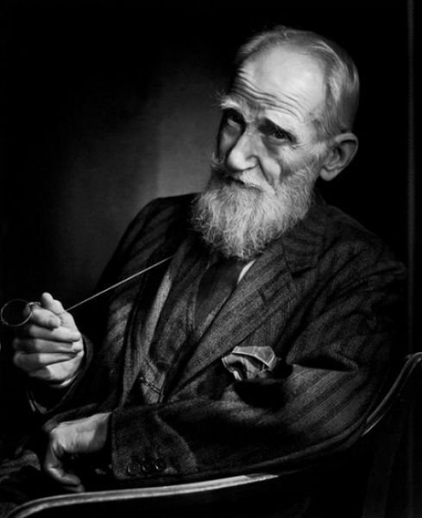
“America and England are two countries divided by a common language.”
George Bernard Shaw, 20th century writer

Slide 3
Lead-in
Although UK and USA speak a common language, differences exist. Do you know some of them?

Slide 4
Lead-in
Differences
between A.E. & B.E.
American English
British English
Examples
Aspects
跳舞
[dæns]
[dɑːns]
pronunciation
足球
soccer
football
vocabulary
颜色
color
colour
spelling
communication styles

Slide 5
A Exploring the rules
Read the personal account on page 20 and fill in the following table.
Communication styles
In the UK:
In the USA:
British people are especially polite when communicating.
indirect
Americans tend to get straight to the point when communicating.
direct

Slide 6
No sooner had I begun to understand how British people communicate than it was time to head back home.

Slide 7
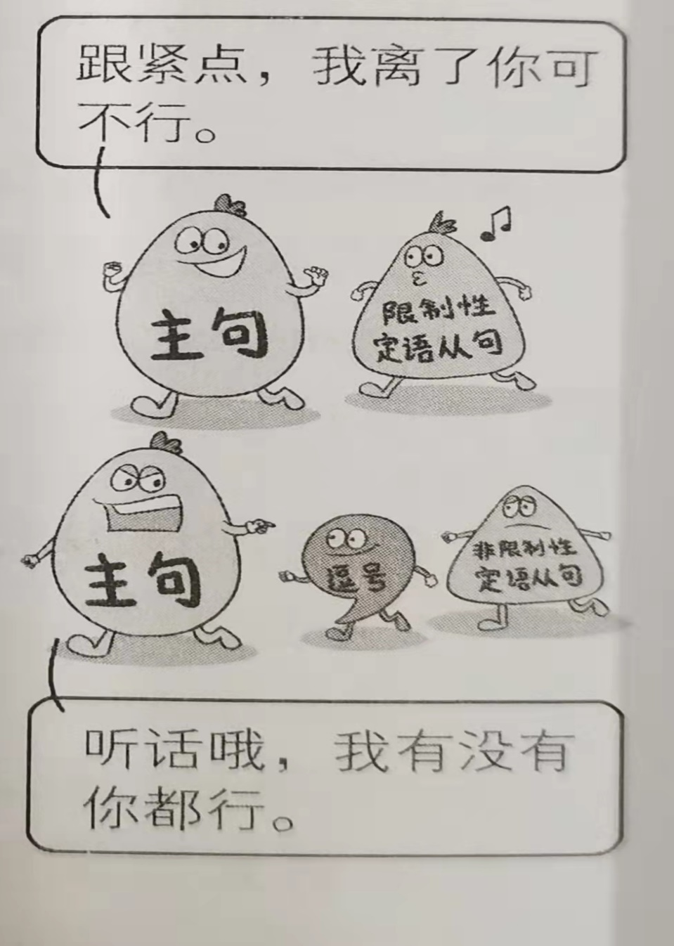
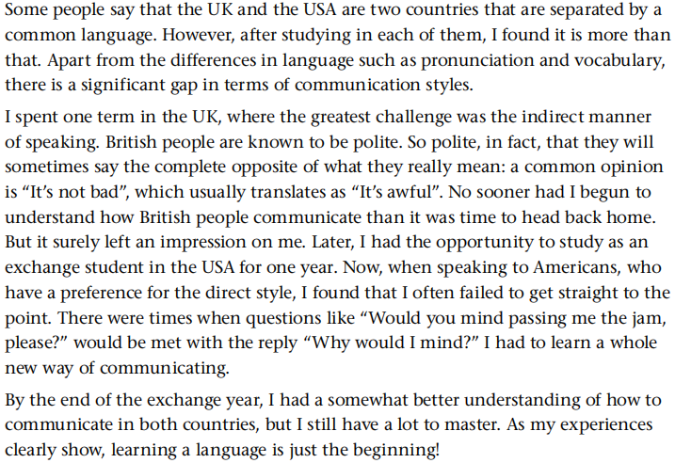
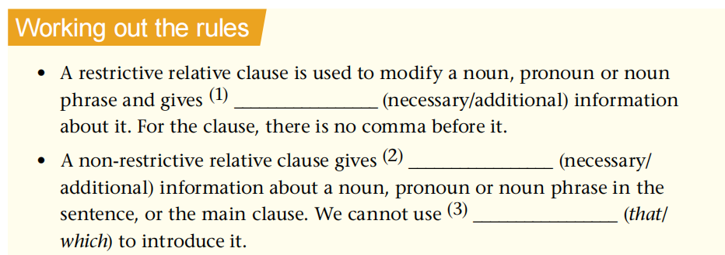
relative clauses 定语从句
A Exploring the rules
个人陈述
1
Below is a personal account by a Chinese student who studied in the UK and the USA. Find the sentences with relative clauses and fill in the table below. The first one has been done for you.
restrictive relative clause 限制性定语从句
2
3
4
necessary
5
additional
non-restrictive relative clause 非限制性定语从句
that

Slide 8
基础知识回顾: 关系词及其意义
关系代词
指代人
指代事物
所属关系
指地点
指时间
指原因
who, whom, that, as
which, that, as
whose
where
when
why
归纳总结
关系副词
做题技巧?
先分析定语从句中缺少什么成分

Slide 9
基础知识回顾 B1：
where
1. In the UK, ________ punctuality is very important, you should try not to arrive late.
2. In Thailand, the foot, ________ is considered an unclean part of the body, should not be pointed.
3. In Europe, there are many different types of greetings, _________ cheek kissing is just one example, and it is important to know which one to use.
4. When we travel, we should pay attention to situations ________ there might be unwritten rules, such as gift giving.
5. My sister, ______ works in Japan, finds it odd that she has to do exercise at the start of her working day.
which
of which
where
who

Slide 10
The passage below is about taboos. Complete it with the correct relative clauses in the box below. There are two clause you do NOT need to use. Write the letters in the blanks. .
B 2
A taboo is social behaviour that is not allowed. There are many different taboos around the world, (1) ______. They often vary from society to society. Taboos are usually related to certain items or people. Those (2) ______ are likely to feel upset or embarrassed even if they have no intention of hurting others, and the situation will also be awkward for the people around them.
a
e

Slide 11
B 2
When you meet people from different cultures. It is important to understand what you cannot do. If you are not aware of the differences, (3) ______, some strange things might happen. For example, in China, giving an umbrella as a gift to your friend or a married couple, except when it is actually raining, should be avoided. This is because the word that corresponds to “umbrella” in Chinese sounds like another Chinese word (4) ______
d
f

Slide 12
考点与难点归纳
1.that与which
2.对the way的考查
3.介词+关系词
4.as的使用
5.对where的考查
6.综合考查
考点
难点

Slide 13
考点1：that 与 which
1) Do you have anything ______ you don’t understand?
2) The only thing _____ we can do is to give you some advice.
3) Who is the man _____ is standing there?
4) Her bag, in _______ she put all her money, has been stolen.
5) She heard a terrible noise, ______ brought her heart into her mouth.
that
that
that
which
which

Slide 14
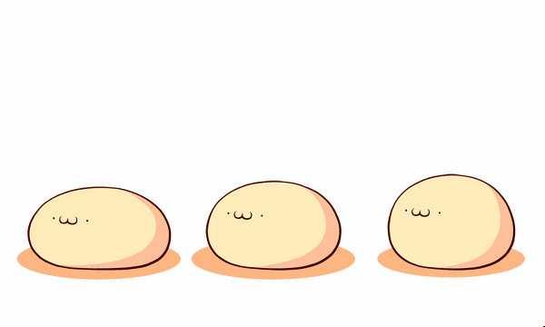
1:先行词是everything, nothing, anything, something, much, little, none等不定代词或由不定代词any, some, no, much, few, little, every, all等修饰时, 引导定语从句用that。
2：先行词被形容词最高级或序数词修饰且指物时, 引导定语从句用that 。
3: 先行词中既有人又有事物时，引导定语从句用that 。
4：先行词被the very, the only等修饰且指物时,引导定语从句用that。
5：当先行词前面有who/which等疑问代词时，只用that。
指物，介词后。
2. 用于非限制定语从句中
只使用which应遵循的规则
只使用that应遵循的规则

Slide 15
考点2：the way用做先行词
1.The way _________________he explained the sentence to us was not difficult to understand.
2.The way _________________he explained to us was quite simple.
缺状语
that/in which/不填
that/ which/不填
缺宾语
做题技巧?
the way 做先行词时,先看后面定语从句中是否缺少主语或宾语:
that / which / 不填(缺宾语时)
缺少主语或宾语:
主语宾语都不缺:
that / in which / 不填

Slide 16
考点2：the way用做先行词
高考链接：
3. What surprised me was not what he said but _____ he said it. （04湖北）
A. the way B. in the way that
C. in the way D. the way which

Slide 17
考点3：介词+关系词
关系代词前介词(介词＋which)的确定
1. 根据从句中动词与先行词的逻辑关系
Is that the newspaper ____ which you often write articles?
2. 根据从句中动词或形容词的习惯搭配
Can you explain to me how to use these idioms ______ which I'm not sure?
3. 根据先行词与介词的搭配习惯
1949 was the year ____ which the P.R.C. was founded.
for
about
in

Slide 18
考点3：介词+关系词
做题技巧?
定语从句句首为介词时,后可接的关系词为:
介词+whom / which / whose
whose
6. I recognized the boss in ______ company my sister was working.
7. (06浙江) I was given three books on cooking, the first ______I really enjoyed.
A. of that B. of which C. that D. which

Slide 19
难点一：as的用法
as\that\which
1. It is such a big stone _____ nobody can lift.
2. It is such a big stone _____ nobody can lift it.
3. ______ is known to all, he is the best student.
4. Jim passed the driving test, _______ surprised everybody in the office.
as
that
As
which
归纳：as引导限制性定语从句先行词前常被such, the same, so, as 修饰，即构成such…as , the same …as, so…as, 结构。
as在定语从句中应充当成分如：主语、宾语或表语。
as 与which引导非限制性定语从句都能指代整句内容，但定语从句位于句首时，只能用 as, 意为“正如、恰如”。

Slide 20
as用法
as(表同类)... that（表同一个）...
the same...
限：
so/such ...as..
非限：
as is said/as has been said before/as mentioned before as is reported as we all know/as is known to us all as is often the case as sb. put it as a proverb goes as often happens as is shown in the chart as anybody can see as is expected as sb. points out

Slide 21
模拟训练 ：
1. He is such a lazy man_____ nobody wants to work with______.
A. as; him B. that; /
C. as; / D. whom; him
2. Mrs. Black took the police back to____ place ____ she witnessed the robbery.
A. the same; as B. the same; where
C. the same ; that D. as the same; as

Slide 22
难点二：一些特殊词之后的where
1. I’ve come to the point where I can’t stand him.
2. The country is in the situation where a war will break out at any time.
我已经到了无法容忍他的地步了。
国家正处在随时有可能爆发战争的局势中。
解析：如果定语从句分别修饰point, situation, part, condition, case等表示抽象意义的词，常用where 引导，意思是“到了某种地步，在某种境况中” 。

Slide 23
难点二：一些特殊词之后的where
高考链接：
1.We are trying to reach a point ____ both sides will sit down together and talk. （06山东）
A. which B. that C. where D. when
2. ---Do you have anything to say for yourself?
---Yes, there’s one point ____ we must insist on . （06江西）
A. why B. where C. how D. /
做题要灵活：要分析句子成分，选择恰当的关系词。

Slide 24
难点三.综合考查
友情提示
近年来，高考对定语从句和其它从句如：强调句、名词性从句和状语从句等的综合考查越来越多，这就要求考生有扎实的基础知识和较强的综合分析能力。
一. 定语从句与强调句
where\that
1.This is the library _______ I borrowed the book.
2.It is from this library ______ I borrowed the book.
3. ---Where did you last see Mr. Smith?
---It was in the hotel____ I lived.
A. that B. which C. where D. when
定语从句
where
that
强调句型

Slide 25
二. 定语从句与同位语从句
that/which
1. We all have heard the news _____ our team won.
2. We don’t believe in the news ____________ he told us yesterday.
that
that/which/—
三. 定语从句与表语从句
The place ____ the bridge is supposed to be built should be_____ the cross-river traffic is the heaviest. （05 江苏）
A. which; where B. at which; which
C. at which; where D. which; in which

Slide 26
高考实战
1. Moreover, fully consider each option. It can be easy to let a particular school become a front-runner early on in your decision-making process …, but be sure to carefully evaluate every school ______ has accepted you, since you had particular reasons for applying to each school. （2021年八省联考语言运用第二节）
that
解析：空处引导定语从句，并在定语从句中作主语，而先行词tool为物，故此处要填关系代词that或which。

Slide 27
高考实战
2. BMI is an internationally recognized measurement tool __________ gives an indication of whether someone is a healthy weight.
（2021年1月浙江卷语言运用第二节）
that/which

Slide 28
高考实战
3. Southbank, at an eastern bend in the Thames, is the center of British skateboarding, _______ the continuous crashing of skateboards left your head ringing.
（2021年全国甲卷阅读理解C篇）
where
解析：整句的谓语是is，at an eastern bend in the Thames是后置定语，修饰主语Southbank; 空处引导非限制性定语从句，修饰主语Southbank，并在从句中作地点状语，故填where。

Slide 29
高考实战
4. When the explorers first set foot upon the continent of North America, the skies and lands were alive with an astonishing variety of wildlife…. Unfortunately, it took the explorers and the settlers _____ followed only a few decades to decimate a large part of these resources.
[2021·新高考Ⅰ卷·阅读理解C篇]
who
解析：空处引导限制性定语从句，修饰先行词the explorers and the settlers，并在定语从句中作主语，故填who。

Slide 30
高考实战
1. Many lessons are now available online, from ___ students can choose for free. [2020江苏卷]
A. whose B. which C. when D. whom
2. Dr. Rowan, ____ secretary resigned two weeks ago, has had to do all his own typing. [2020天津高考真题]
A. whose B. of whom C. of which D. which
3. We have entered into an age ____ dreams have the best chance of coming true. [2019·江苏卷·单项填空]
A. which B. what C. when D. that

Slide 31
高考实战
1. The naughty boy told the headmaster everything _____ was connected with the theft.
2. Through my stay in Montreal, I met lots of Chinese people ________ are struggling to succeed and then lead a better life in Canada.
3. I didn't buy the cellphone, ______ price was too high for me.
4. More importantly, there are teachers online ________ you can turn for help when you have problems.
that
that/who
whose
to whom

Slide 32
高考实战
5. We're just trying to reach a point ______ both sides will sit down together and talk.
6. In the U.S., the fourth Thursday in November is called Thanksgiving Day, ______ Americans give thanks for the blessings they have enjoyed during the year.
7. One reason ______ the course is so popular is that it provides people with more knowledge.
8They arrived at a farmhouse, in front of ______ sat a small boy.
where
when
why
which

Slide 33
The end.

