Slide 1
卷别 |  | 项目
 |  | 语篇 类型 | 语篇主题 |  | 命题角度
 |  |  | 主题语境 | 语境内容 | 动词 | 名词 | 形容 （副）词 | 其 他
2022 | 新高考Ⅰ卷 | 记叙文 | 人与自我 | 家庭生活 | 5 | 5 | 4 | 1
 | 新高考Ⅱ卷 | 记叙文 | 人与自然 | 社会交往 | 4 | 6 | 4 | 1
2021 | 新高考Ⅰ卷 | 记叙文 | 人与自我 | 积极的生活态 度 | 9 | 4 | 2 | 0
 | 新高考Ⅱ卷 | 记叙文 | 人与社会 | 对社会有突出 贡献的人物 | 7 | 7 | 1 | 0

Slide 2
卷别 |  | 项目
 |  | 语篇类型 | 语篇主题 |  | 命题角度
 |  |  | 主题语境 | 语境内容 | 动词 | 名词 | 形容 （副）词 | 其 他
2020 | 新高考Ⅰ卷 | 记叙文 | 人与自然 | 环境保护 | 5 | 7 | 3 | 0
 | 全国Ⅰ卷 | 夹叙夹议 | 人与自我 | 完善自我 | 6 | 8 | 5 | 1
 | 全国Ⅱ卷 | 记叙文 | 人与社会 | 文化遗产 | 11 | 4 | 5 | 0

Slide 3
What’s a common feature of these articles?
genre(体裁)：narratives (story)

Slide 4
Strageties for narrative cloze tests of new NCEE ——新高考完形填空记叙文解题策略
南京市秦淮中学杨珊珊

Slide 5
Learning obejectives
After learning the class, you will be able to :
Know the latest question setting（问题设置） of NCEE(高考)
Master some basic problem-solving strategies of a narrative cloze
Apply the tricks to improve the ability of solving problems
Summarize the strategies of doing cloze tests.

Slide 6
把握考查方向——知考情
句内层次考查：(level 1)
句内层次题是指那些通过阅读翻译空格处所在的句子就能找出答案的题目，解决这类问题主要是对句子的准确理解和对四个选项的意思的准确把握。
句组层次考查：(level 2)
句组层次题是指那些通过阅读翻译空格处所在的句子，不能找出正确答案，需要结合上下句、本段甚至其他段落内容才能推断出答案的题目。解决这类题目必须要整体阅读，结合上下文的意思，根据创设的情境和故事合理推断发展过程。

Slide 7
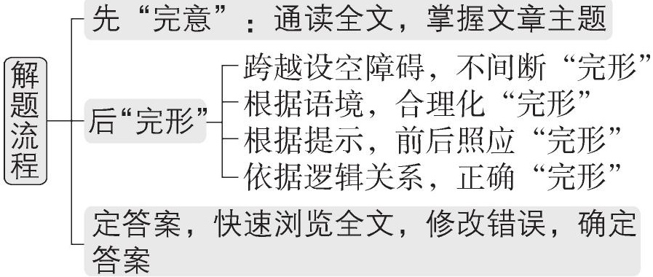
熟练解题流程——提效率

Slide 8
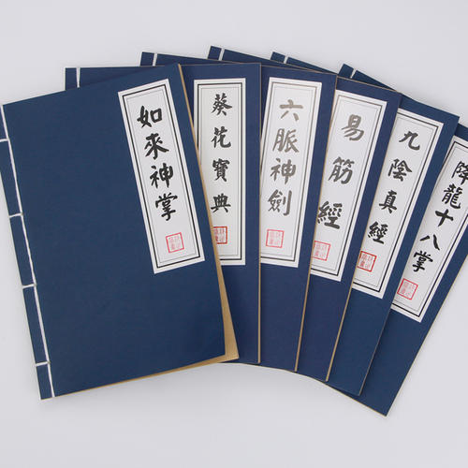
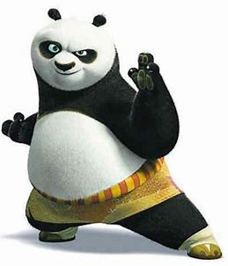
The skills of Cloze
完型填空秘籍

Slide 9
技法点拨
微技能一 逻辑关系定位
完形填空所选短文前后连贯，脉络自然有序，因此我们可以充分利用表达
逻辑关系的单词或短语等快速解题。表达逻辑关系的单词或短语主要有：
单词 | and, but, or, because, though, however, yet, therefore, otherwise, while, despite等
短语 | in other words, in addition, because of, as a result （of）, on the contrary, instead of, that is to say, what’s more, generally speaking等

Slide 10
典例1 [2022全国甲卷片段] While I was thrilled that he was an animal
lover, I 45 that three dogs were perhaps too many, and my dogs might
attack, Flora, the cat.
√
45.( )A.predicted B.worried C.regretted D.insisted
[解析] 思路点拨
表示逻辑关系的关键词While，在此处引导让步状语从句，表达：虽然/尽管……，但……。主句和从句是让步关系，worried与thrilled表达的意思想反。

Slide 11
微技能二 情感态度定向
在第一遍通读全文时，我们要特别注意那些能够反映作者态度和感情色彩
以及评论性质的重要词汇，并画出这些词汇。
典例2 [2021全国甲卷片段] As he was 45 that it would be too warm, he laid it out on the table near an open window.
too
√
25. A. surprised B. pleased C. excited D. worried

Slide 12
微技能三 语境暗示指路
完形填空主要考查在语境中对词义的理解，有些题目利用语境即可快速解
答。我们通常可以通过上下文语境中的关键信息，即根据空前后的相关已知信
息推导出正确答案。
典例3 [2021全国乙卷片段] One afternoon, while attempting to get into bed she collapsed（倒下） from what was eventually discovered to be a heart attack. The collapse was disastrous, . .47. .the emergency medical team and good teamwork.
47.( )A.assessing B.requiring C.forming D.proving
√

Slide 13
微技能四 语义复现导航
完形填空中有些设空的答案在上下文中以原词复现、同义词复现、反义词
复现、同根词复现等方式来提示。我们可以根据文章的具体情况，理解文章结
构和语境，利用这些词汇的复现来推断出正确答案。
典例4 [2020新高考Ⅱ卷片段] On the second floor, he 45 every
apartment door.“Get out!” Grant shouted. No one responded and he assumed
that people had already escaped. Reaching the end of the hallway, though,
Grant noticed a half-open door. He kicked it wide open, finding a frightened
woman in a wheelchair with a little boy and a tiny baby.
kicked
45.( )A.locked B.kicked C.counted D.repaired
√

Slide 14
微技能五 背景知识助力
完形填空中某些设空在文章的上下文是找不到“伏笔”或“暗示”的，这时就要
求学生对设空前后的语境进行合理想象，然后运用排除法确定答案。常用的背
景知识包括：文化背景、生活经验、科普常识等。
典例2 [2021北京卷片段] As the night wore on, people began to close
their eyes, but the seats were so uncomfortable that only a very heavy sleeper could manage to get any 3 .
3.( )A.air B.joy C.space D.rest
√

Slide 15
[2022江苏南京三模]
语篇类型：记叙文 主题语境：人与自我
I was visiting members of my late husband John’s medical team. They had worked hard when he . .1. . lung cancer. Each time I . .2. . them for all they had done, I felt myself gaining closure.
Then I . .3. . to John’s favorite Chinese restaurant. We had gone there after so many of John’s treatments. I wanted to talk to the manager, who knew about our . .4. . and had always been kind to us. When I pulled over, I could hear John’s voice in my car—the . .5. . John told me every time I got behind the wheel: “Drive . .6. ..”
This phrase was one of the ways he showed his . .7. .. I knew that when he said it, he was also saying, “I care about you.”
I took the manager aside. “I want you to know that John has . .8. ..”
She . .9. .. I gave her a hug, and I was . .10. . that there were so many people who cared about us. We exchanged some . .11. . of him and shared a few laughs.
As I was about to leave, I spotted a fortune cookie left by the manager. Should I . .12. . it? I didn’t need a fortune cookie to tell me that life without John would still be . .13. .. Still, just for fun, I opened the cookie and . .14. . a small piece of paper inside.
“The . .15. . ahead is long,” it reads. “Drive safely.”

Slide 16
1. What is the main idea of the passages?
The writer visited her husband’s medical team and favorite Chinese restaurant, where she talked with the manager, sharing the memories of his husband.

Slide 17
2. Who are the main characters(人物) in the article?
The writer , her late husband John, members of John’s medical team, the manager of John’s favorite Chinese restaurant

Slide 18
check Answers
1-5 BCDBB
6-10 DDACD
11-15 ABCAC

Slide 19
句内层次考查：
2, 5, 7, 10, 12, 13, 14, 15
63%70%78%37%67%33%89%
句组层次考查：
1, 3, 4, 6, 8, 9, 11
41%85%63%59%67%67%74%

Slide 20
2.( )A.favored B.supported C.thanked D.praised
√
5.( )A.secrets B.words C.orders D.warnings
√
7.( )A.presence B.devotion C.comfort D.love
√
√
10.( )A.surprised B.cheerful C.satisfied D.grateful
12.( )A.keep B.open C.return D.taste
√
13.( )A.boring B.tough C.full D.stable
√
14.( )A.flattened B.folded C.shared D.grabbed
√
15.( )A.line B.story C.road D.race
√

Slide 21
句内层次考查：
2, 5, 7, 10, 12, 13, 14, 15
情感态度定向——2, 7, 10
逻辑关系定位、语境暗示指路—— 14, 15
背景知识助力(文化背景、生活经验、科普常识等)
——5, 12, 13

Slide 22
1.( ) A.treated B.battled C.survived D.removed
√
√
3.( )A.rushed B.fled C.wandered D.drove
4.( )A.demand B.situation C.preferences D.relations
√
√
6.( )A.bravely B.carefully C.slowly D.safely
8.( )A.passed away B.broken down C.gone away D.backed down
√
√
9.( )A.panicked B.shouted C.cried D.hesitated
11.( )A.memories B.opinions C.expectations D.updates
√

Slide 23
句组层次考查：
1, 3, 4, 6, 8, 9, 11
逻辑关系定位、 语境暗示指路——1, 3, 4, 6, 8, 11
语义复现导航—— 3, 6

Slide 24
[2022山东青岛二模] B
语篇类型：记叙文 主题语境：人与社会
Hank, a two-year-old cat, is a homebody. But recently, he got . .1. . in a tree for five days and four nights
without food or water.
Hank’s big . .2. . started last weekend. He explored the neighborhood . .3. ., and a dog came out, running after
him and sending him flying up a tree.
When Hank’s owner, Delores Bushong, . .4. . him in the neighbor’s tree, she immediately called the Humane
Rescue Alliance for help. . .5. ., Hank was too high for any ladder（梯子） to reach and the tree branch wasn’t
. .6. . enough to support the climb of the rescuer. Bushong felt extremely . .7. ., but her neighbors showed her that
she wasn’t alone.
The neighbor, whose tree Hank had climbed, let Bushong sit in his backyard and . .8. . Hank down. Another
neighbor . .9. . a can of fish, hoping it might attract the . .10. . cat to come down.
On the fifth day, they tried a new . .11. . and it worked! They . .12. . a pulley（滑轮） system by circling a rope around a tall
branch, and . .13. . a basket with some of the owner’s personal items.
The cat, following the familiar scent, climbed into the basket and was . .14. . from the tree.
Bushong said the help of her community was . .15. ., and Hank’s adventure taught her a lesson about neighbors helping
neighbors!

Slide 25
句内层次考查：
1, 4, 5, 6, 7, 8, 9, 10, 12, 13, 14, 15

Slide 26
1.( )A.injured B.stuck C.involved D.lost
√
5.( )A.Typically B.Surprisingly C.Unfortunately D.Strangely
√
6.( )A.smooth B.stable C.flexible D.fixed
√
7.( )A.shocked B.embarrassed C.ashamed D.helpless
√
8.( )A.talk B.catch C.bring D.frighten
√
√
9.( )A.received B.donated C.preserved D.sold
10.( )A.energetic B.hungry C.curious D.cautious
√
12.( )A.created B.repaired C.bought D.texted
√
13.( )A.made B.carried C.raised D.decorated
√
14.( )A.comforted B.protected C.returned D.lowered
√
15.( )A.responsible B.serious C.available D.remarkable
√

Slide 27
句内层次考查：
1, 4, 5, 6, 7, 8, 9, 10, 12, 13, 14, 15
逻辑关系定位、语境暗示指路——1, 4, 5, 7, 12
背景知识助力(文化背景、生活经验、科普常识等)
—— 6, 8, 9, 10, 13, 14
情感态度定向——15

Slide 28
句组层次考查：
1, 2, 3, 11

Slide 29
1.( )A.injured B.stuck C.involved D.lost
2.( )A.practice B.challenge C.adventure D.appearance
√
3.( )A.by chance B.in turn C.on time D.as usual
√
4.( )A.rescued B.observed C.trained D.spotted
5.( )A.Typically B.Surprisingly C.Unfortunately D.Strangely
6.( )A.smooth B.stable C.flexible D.fixed
7.( )A.shocked B.embarrassed C.ashamed D.helpless
8.( )A.talk B.catch C.bring D.frighten
9.( )A.received B.donated C.preserved D.sold
10.( )A.energetic B.hungry C.curious D.cautious
11.( )A.instruction B.opinion C.approach D.choice
√
12.( )A.created B.repaired C.bought D.texted
13.( )A.made B.carried C.raised D.decorated
14.( )A.comforted B.protected C.returned D.lowered
15.( )A.responsible B.serious C.available D.remarkable

Slide 30
句组层次考查：
2, 3, 11
语境暗示指路—— 2, 3, 11
语义复现导航—— 2

Slide 31
Tricks
2-3分钟内进行缺词阅读，密切注意_____________，弄清文章两条线—— 及 。
首尾段
情节线
感情线
瞻前顾后
2. Look back and forward
3. Use your grammar knowledge
运用语法知识
4. Use your common sense
运用常识

Slide 32
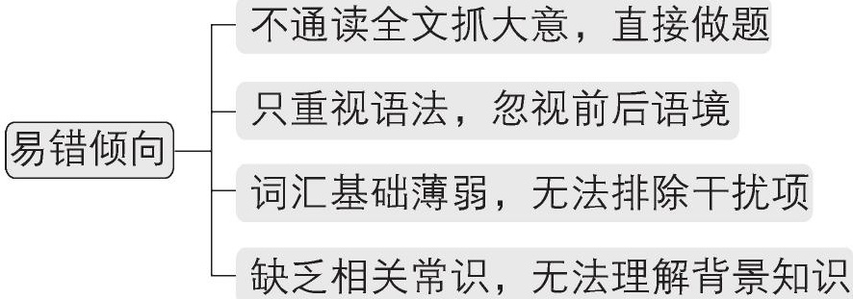
明确考查重点——提效率

Slide 33
Homework：
1. Summarize the strategies and skills used in dealing with cloze tests.
2. Finish the cloze test in the exercise book.

