Slide 1
Attributive Clause
定语从句
Actions speak louder than words

Slide 2
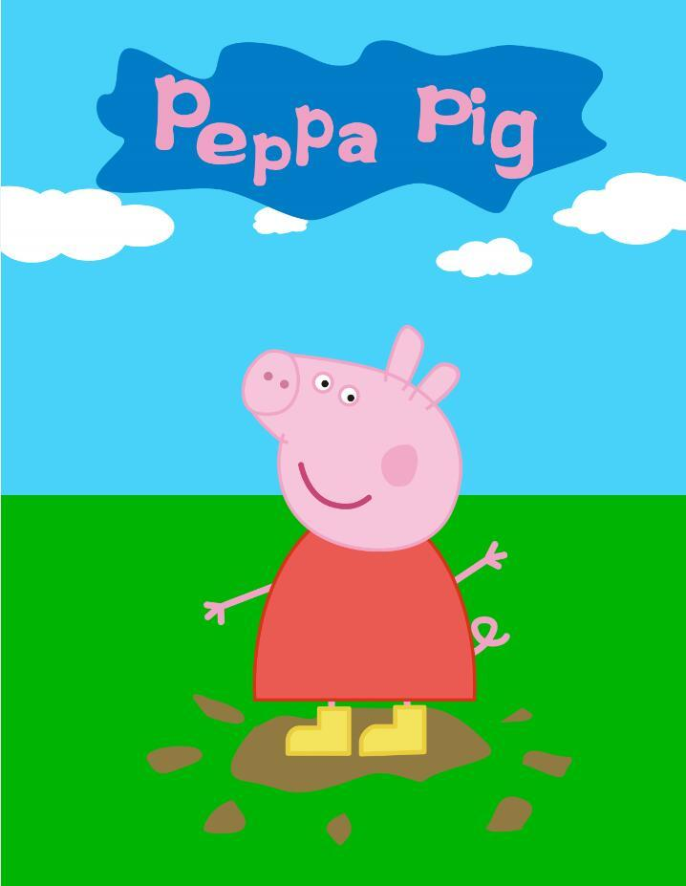
定语从句
我看了那卡通片。
那就是粉红小猪。
I watched a cartoon.
The cartoon is Peppa Pig.
我看了那叫粉红小猪的卡通片。
I watched a cartoon which is Peppa Pig.

Slide 3
定语从句: 限制性定语从句&非限制性定语从句
1. Definition(定义)
2. 先行词&关系词(连接词，指代先行词，从句充当成分)
3. 关系代词:
1) 作主语/宾语
作定语(表从属关系)
2) 代指物时:!只能用that的情况
!只能用which的情况
4. 关系副词

Slide 4
Definition定义
定语从句：在复合句中作定语修饰主句中某一名词或代词的从句叫定语从句。
先行词：被定语从句修饰的名词或代词，叫作先行词。
关系词：引导定语从句的词，叫作关系词。它有三个作用(1.连接从句;2.指代先行词;3.在从句中充当成分)
关系词relative
I watched a cartoon which is Peppa Pig.
先行词 antecedent
/,æntɪ'siːd(ə)nt/
attributive clause

Slide 5
Find the antecedent and the relative of the attributive clause
1. He is the man that I saw yesterday.
2. They work in a factory that makes radio parts.
3. I have a friend who likes listening to pop music.
4. The first thing that we should do is to get some food.

Slide 6
定语从句
 | 缺主语 | 缺宾语 | 不缺主语/宾语 |  | 介词后面
 |  |  | 有所属关系 | 无所属关系
先行词: 人 | who/ that | whom/that/省略 | whose |  | whom
先行词: 物 | which/ that | which/that/省略 | whose | when/why/where | which

Slide 7
关系代词
1. He is the man that I saw yesterday.
2. They work in a factory that makes radio parts.
3. I have a friend who likes listening to pop music.
4. The first thing that we should do is to get some food.

Slide 8
1. Is he the man who/that wants to see you?
2. He is the man whom/that I saw yesterday.
3. The package which/that you are carrying is about to come unwrapped.
4. That is one of the most interesting books that are sold in the bookshop.
5. The first thing that we should do is to get some food.
6. Nothing that the teacher does doesn't influence his students.
7. My necklace is not the only thing that is missing.
8. China is no longer the country that she was.
主语
宾语
宾语
主语
宾语
宾语
主语
宾语

Slide 9
关系代词
作主语
作宾语
作定语
1. The man stands therewho/that wants to see you.
2. The man stands there whom/that/(省略) I saw yesterday.
3. This is the cat which/that ate the fish.
4. This is the cat which/that/(省略) I decide to buy.
5. A child whose parents are dead is called orphan(孤儿).
6. This is the house whose roof is broken.

Slide 10
关系代词
作主语
作宾语
作定语
成分 | 代替人 | 代替物
主语
宾语
定语
who/that
which/that
whom
/that/省略
which/that
/省略
whose
whose

Slide 11
Exercise
who/that
1. I hate the people __________________ don't keep their words.
2. This is the school __________________ locates in Zhuhai.
3. This boy ______________ father is a policeman made a mistake at school.
4. He still remembers the days _____________ he spent with your family.
5. Mr. Liu is the person _________________ you talked to in the street.
which/that
whose
which/that/省略
whom/that/省略

Slide 12
Rules
当关系代词作定语从句宾语时，常将介词提前，用介词加关系代词引导定语从句。
e.g. The man about whom you talked is kind.
2. 用介词加关系代词引导定语从句时，不可用 that 或 who。如果指“人”，用 “介词+ whom”; 如果指“物”，用“介词+ which”。
e.g. The park is a place to which I often go.
My cousin is a person with whom I can
discuss my homework.
1. 确定连接词前的介词为从句成分
2. 符合：“介词+宾语”结构
代指人： 介词+whom
代指物： 介词+which

Slide 13
3. 在不正式的场合，介词可置于从句末尾处。此时，若关系代词作从句的宾语，可省略。
e.g. Literature is a subject which I know little about.

Slide 14
Practice
1、看定语从句中动词与介词的搭配
which
This is the book for ______ you asked.
which
know
Art is something about _______ I know little.
The teacher from ______ I learnt most
was Mrs Zhu.
whom
learnt

Slide 15
Practice
2、看定语从句中形容词与介词的搭配
The West Lake, for ______Hangzhou
is famous, is a beautiful place.
which
famous
whom
Eric is the boy with _____ his father is
strict.
Eric is the boy on _____ his father is hard.
strict
whom
hard

Slide 16
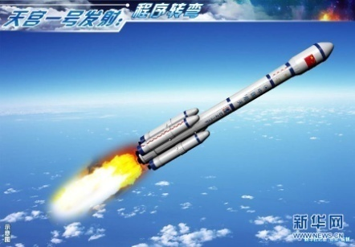
3、根据先行词判断，所用的介词与先行词搭配
Sep. 29th was the day ___ _____ Tiangong I was launched (发射).
on which
Practice
at which
The speed ___ _______ light travels is said to
be the fastest in the universe.
speed

Slide 17
关系代词:指代事物
只用that不用which： 从句：关注先行词
1. 先行词是最高级或被最高级修饰；
2. 序数词或被序数词修饰；
3. 不定代词:all, few, little, something..
4. 既有人又有物;
5. 被only, the very, no, one of等修饰时；
6. 前已有which;
7. 作表语:先行词-主句
or 关系词-从句
1. That is the most interesting book that are sold in the bookshop.
2. The first thing that we should do is to get some food.
3. All that parents do have a great influence on their children.
4. The girls and the cats that turn up on the scene(在场) are from the same association(协会，社团).
5. My necklace is not the only thing that is missing.
6. Who is the person that talked to you just now?
7. China is no longer the country that she was.

Slide 18
关系代词:指代事物
只用which不用that： 从句：
1. 介词+which
=when/where...
2. ,+which
1. The world in which we live is made of matter.
2. The sun heats the earth, which makes it possible for plants to grow.

Slide 19
Exercise: Which or That?
that
1. You should hand in all __________ you have.
2. What is the first American film___________ you have seen?
3. This is the most exciting film__________ I ever seen.
4. Football, __________ is a very interesting game, is played all over the world.
5. He lived in a big house, in front of_________ stood a big tall tree.
6. They talked about the persons and things ________ they remembered at school.
7. This is the book _______________ I like so much.
that
that
which
which
that
that/which

Slide 20
介词+which
The school which/that/省略 he once studied in is very famous.
=The school in which he once studied is very famous.
Tomorrow I will bring here a magazine which/that/省略 you asked for.
=Tomorrow I will bring here a magazine _______which you asked.
We'll go to hear the famous singer who/whom/that/省略 we have often talked about.
=We'll go to hear the famous singer _______ whom we have often talked.
The man _________ whom you talked is my friend.
The English play _________ which my students actd at the New Year's party was a great success.
for
about
to
in

Slide 21
关系副词
作状语
关系副词 | 先行词 | 在从句中的成分
I won't forget the happy hours when we played basketball together.
when
名词，表时间
时间状语
where
名词，表地点
地点状语
why
reason，表原因
原因状语

Slide 22
Exercise: When、Where or Why?
why
1. I don't know the reason __________ he came so late.
2. I still remember the days___________ we had a great time.
3. The treatment(治疗方案) will continue until the patient(病人) reached the point ________ he can walk correctly and safely.
=》I still remember the days ___________ we spent together.
The reason ___________ he gave is unreasonable.
when
where
that/which/省略
that/which

Slide 23
做题思路：
1.照妖镜：确定是人是物，确定应对方式（选择关系词）
2.扫描仪：分析定语从句成分：
若缺主语/宾语，人用who/whom/that/省略；
若主谓/主谓宾完整，看关系词前后名词是否有所属关系，“属于”则用whose；
若以上两点皆不对，则考虑缺状语，先行词是啥就填啥。
3.显微镜：鹰眼留意关键词，重视which&that的区别，还有介词+which、介词+whom的使用

Slide 24
Exercise(请使用适当的关系词，介词+关系词)
1. This is the boy ________ father died three years ago.
2. They work in a factory ________ makes radio parts.
3. Tom works in a factory ________ his father used to work.
4. This is the vision phone _________ we can see and talk to our friends through.
5. I am looking forward to the day _________ my daughter can read this book and know my feelings.
6. Those _________ want to go to the computer room write your names here.
7. He talked about the teachers and schools _________ he had visited.
whose
which/that
where
which/that/省略
when
who
that

Slide 25
定语从句常见错误
1. 缺少先行词
Is this school that you visited last year?
=> This school is that you visited last year.
2. 缺少引导词/关系词/连接词
Children eat a lot of sugar often have bad teeth.
3. 成分重复
This is the village that I lived in it years ago.
4. 谓语单复数确定不当
He is the only one of the students who know French.
5. 关系代词省略不当
This is the girl from I learned the news.
the one
who
/
s
whom

Slide 26
限制性定语从句VS 非限制性定语从句
,
1. 可不可以省略定语从句
This is the girl that I called last night.
I love flowers, which smell good.
2. 把握一个符号
关系代词:
who/ whom/ that/ which/ whose
关系副词:
when/ where/ why
/
+as
/

Slide 27
定语从句
As VS Which
as | which
指代整个主句 | 指代整个主句或者主句中的部分成分(如：主语、宾语)
放于句首、句中、句末 | 放于句中、句末，不能放于句首
意思：正如，正像... | 指代先行词
固定搭配：as we know, as is reported, as is known to all...

Slide 28
定语从句
 | 缺主语 | 缺宾语 | 不缺主语/宾语 |  | 介词后面
 |  |  | 有所属关系 | 无所属关系
先行词: 人 | who/ that | who/whom/that/省略 | whose |  | whom
先行词: 物 | which/ that | which/that/省略 | whose | when/why/where | which
先行词为物
有以下成分出现 | 连接词
最高级;序数词;不定代词;the very等修饰;先行词既有人又有物; 前已出现who此类词;作表语 | 只能用that
介词(常考动词词组)；逗号“，” | 只能用which

Slide 29
谢谢观看
THANK YOU

