Slide 1
非谓语动词

Slide 2
非谓语动词形式复习
doing主动进行
having done已经完成
doing
being done正在被做
having been done已经被完成
done
done完成 | 被动
to do将要做 | 为了
to do
to be done将要被做 | 为了被

Slide 3
非谓语动词的语态
有宾语为主动
及物动词
无宾语为被动
判断语态
不及物动词
主动
被动时作定语置于名词前
falling leaves
fallen leaves
表动作完成了

Slide 4
Step 2 错题回顾
1
2
3
4

Slide 5
step1：错题回顾
I was the first Western TV reporter (permit) to film a special unit caring for pandas rescued from starvation in the wild.
permitted

Slide 6
step2：错题回顾
2. ________________ (expose) to the sun for a long time will do harm to your skin.
Being exposed

Slide 7
step2：错题回顾
3 . ___________( find) out more about university courses, call (020) 746-3789.
____________( face ) so much trouble, we failed to complete the task on time.
____________( face ) with so much trouble, we failed to complete the task on time.
To find
Facing
Faced

Slide 8
step2：错题回顾
4. His first book ______________________(publish) next month
is based on a true story.
to be published

Slide 9
Step 3 比较

Slide 10
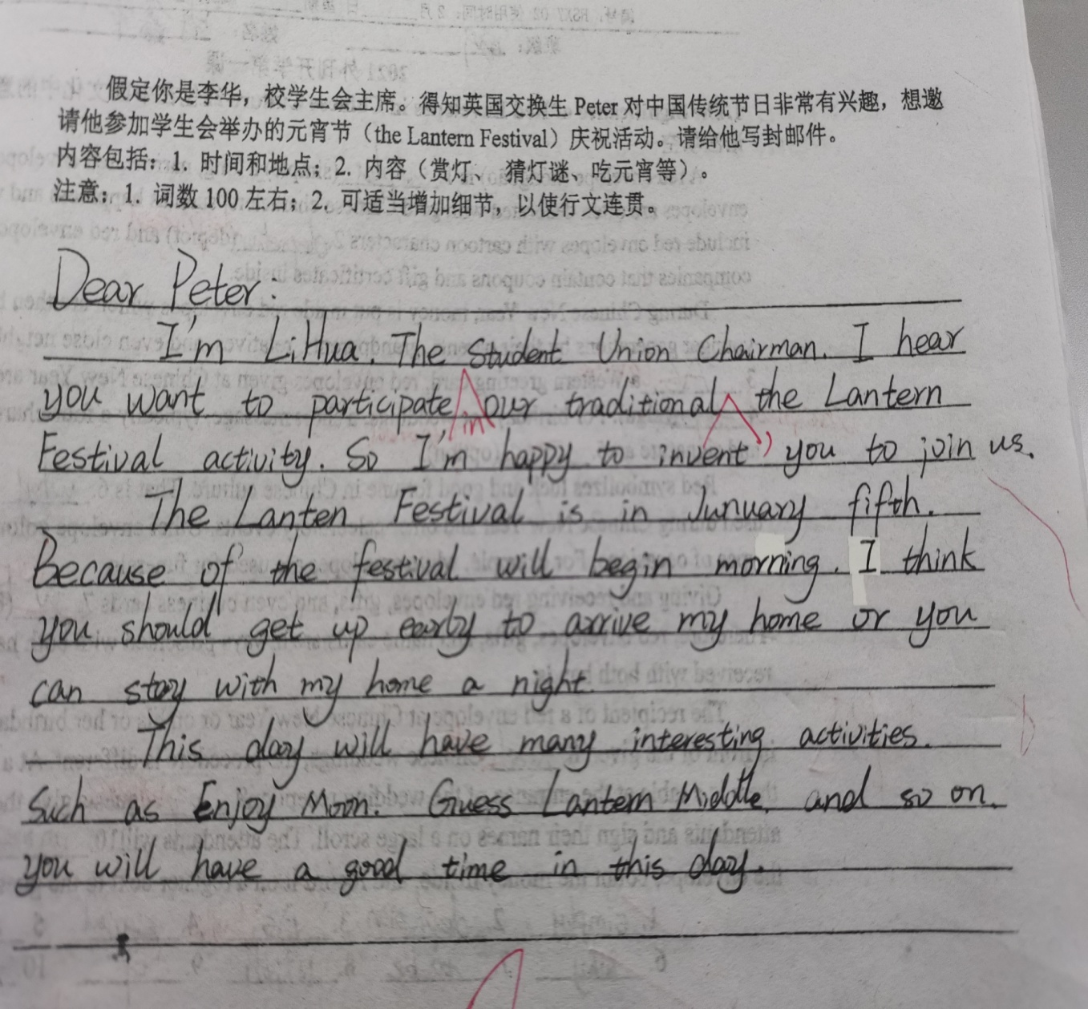
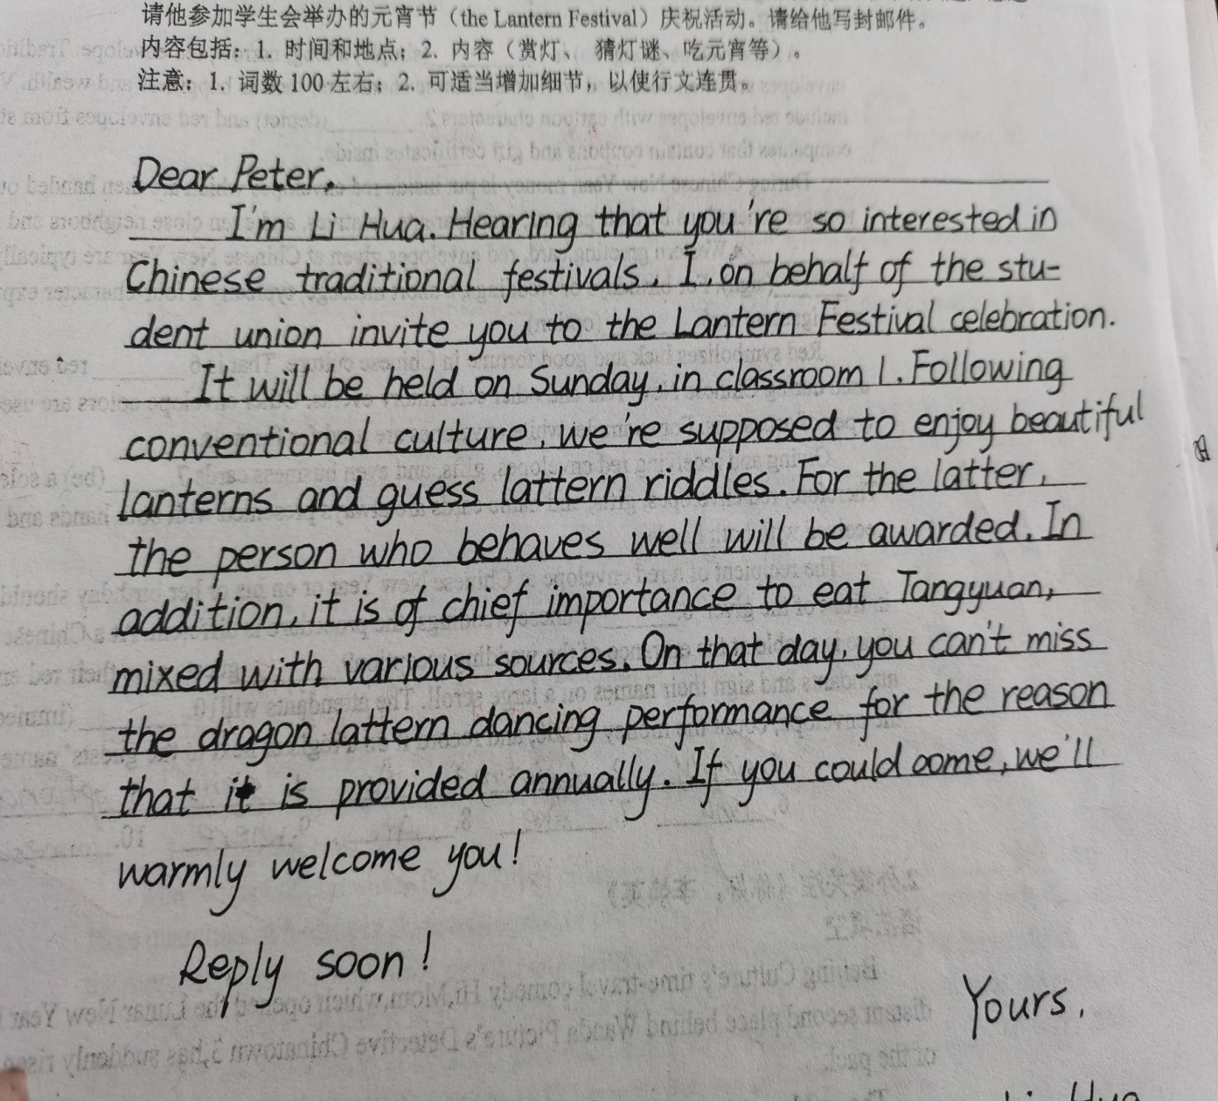

Slide 11
Step 4 观察

Slide 12
1. Eric runs in after it, followed by a big dog, walking very slowly.（M1U2）
2. We’ll be travelling by camel with local guides, camping in tents and sleeping on the ground.（M2U2）
3. To reduce the risk of a shark attack, you should follow these suggestions.（M3U3）
伴随状语
伴随状语
目的状语

Slide 13
4.This kind of urban planning is in the long term cheaper and more practical, compared with the way most urban planning is done today.（M4U3）
5.Asking around, I find many people willing to pay a little higher price for things that are friendly to the environment.（M5U2）
6.Given enough time, we will see the whole city.(M6U2)
条件状语
时间状语
条件状语

Slide 14
Step 5 总结
非谓语动词作状语的高级句式

Slide 15
句型 1：Doing/Done/To do..., 主 + 谓...
doing作状语，逻辑主语与句子的主语一致，构成主动关系；有时可以在doing前加before, after, while等; 但如果是被动关系，使用过去分词done作状语;如果表目的，使用动词不定式。例如：
1. _________（reduce）the risk of a shark attack, you should follow these suggestions.（M3U3）
2._________(ask)around, I find many people willing to pay a little higher price for things that are friendly to the environment.
3.________ (give) enough time, we will see the whole city.(M6U2)
To reduce
Asking
Given

Slide 16
句型2：主+谓..., doing/done/to do...
doing作伴随状语，与句子的谓语动词同时发生，逻辑主语与句子的主语一致，构成主动关系；如果是被动关系，应该使用过去分词done作状语。例如：
1.Eric runs in after it, _______(follow) by a big dog, ______(walk) very slowly.
2.We’ll be travelling by camel with local guides, ________(camp) in tents and ________(sleep) on the ground.（M2U2）
followed
walking
camping
sleeping

Slide 17
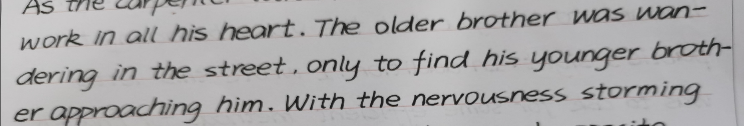
The older brother was wandering in the street, only to find his younger brother approcoaching him.
句型2：主+谓..., doing/done/to do...

Slide 18
句型3： 主1+谓..., 主2 + doing/done ...
有时独立主格成分放在句首：主2 + doing/done, 主1+谓...
逻辑主语2与doing构成主动关系，构成独立主格。该句型有时可以转化为并列句：主1+谓...and 主2+谓...。例如：
welling
1) He stood there, tears of gratitude _______(well) up in his eyes.
--He stood there and tears of gratitude _______________(well) up in his eyes.他站在那里，眼里涌出感激的泪水。
2) The girl ___________(stare) at him, he didn't know what to say.
姑娘两眼望着他，他不知道说什么好。
welled
staring

Slide 19
Step 6 改写&改错

Slide 20
1. The video inspired many young people to work harder. (by Li)
Possible version：Inspired by the video, many young people were determined to work harder.

Slide 21
2. They were cooperated to push the fence together and then they smiled in relief again.(by Zhou)
Possible version：Cooperating with each other to push the fence, they smiled in relief.

Slide 22
3.The older brother approved, and the younger glittered on the excitement.(by Wang)
Possible version：Approved by his elder brother, the younger brother’s eyes glittered with excitement.

Slide 23
4.I had saw that you spoke English smoothly with Tim Cook. Your English and altitude in it has inspired my study spirit.(by Tang)
Possible version：Having seen that you spoke English smoothly with Tim Cook, I was inspired by your fluent English and positive attitude, stimulating my spirit of study./my enthusiasm for English spreading.

Slide 24
5.He was very regreted for his behavior and his words. So he decided to made an apologize to his elder brother.(by Yang)
Possible version：①Regretted for what he has done and said, he decided to make an apology to his elder brother.
②He was extremely regretted for what he has done and said, deciding to make an apology to his elder brother.

Slide 25
6.The older brother looked at the bridge and a light wind disturbed the surface of the water.(by Yu)
Possible version：The older brother looked at the bridge, a light wind disturbing the surface of the water.

Slide 26
Step 7 好句积累

Slide 27
1.Watching his construction, he couldn’t contain his joy.
2.Hearing the words, a wave of warmth flooded over him.
3.He shocked all over, feeling like sitting on needles and pins.
…

Slide 28
1. The girl began kicking and swinging, trying to get free of the man's hold.女孩开始又踢又晃，试图摆脱这个男人的控制。
2.Her father was lying on his back, trapped under the truck.
她父亲仰面躺着，被困在卡车下面。
3.Bitter memories of the man's harsh words came flooding back to her.
她又痛苦地想起了那个男人刺耳的话。
4.Her dad was still conscious, yelling, “One more try!”
她爸爸仍然清醒，大声喊道: “再试一次!”
5.“It's OK,” Mama said,comforting me with a hug.
“没关系,” 妈妈说，用拥抱安慰我。

Slide 29
6. He stood there, tears of gratitude welling up in his eyes.
他站在那里，眼里涌出感激的泪水
7.The girl staring at him, he didn't know what to say.
姑娘两眼望着他，他不知道说什么好。
8.She opened the letter, her hands trembling with excitement.
她打开信，激动得双手发抖。
9.“Don't stand in my way,”Tim yelled out, his voice quivering with rage.
“别挡我的道,” 蒂姆喊道，他的声音因愤怒而颤抖。
10.Foster stared at his car, trembling/shaking with rage.
弗利斯特盯着他的汽车，气得浑身发抖。

Slide 30
Thanks for listening!

