Slide 1
读后续写:如何通过描写让故事更生动
——以高二期中考试读后续写文本为范本
By Cindy

Slide 2
Teaching objectives:
1.tell the difference between exposition and description;
2.appreciate and imitate examples of description sentences;
3.write a scene using techniques of description.

Slide 3
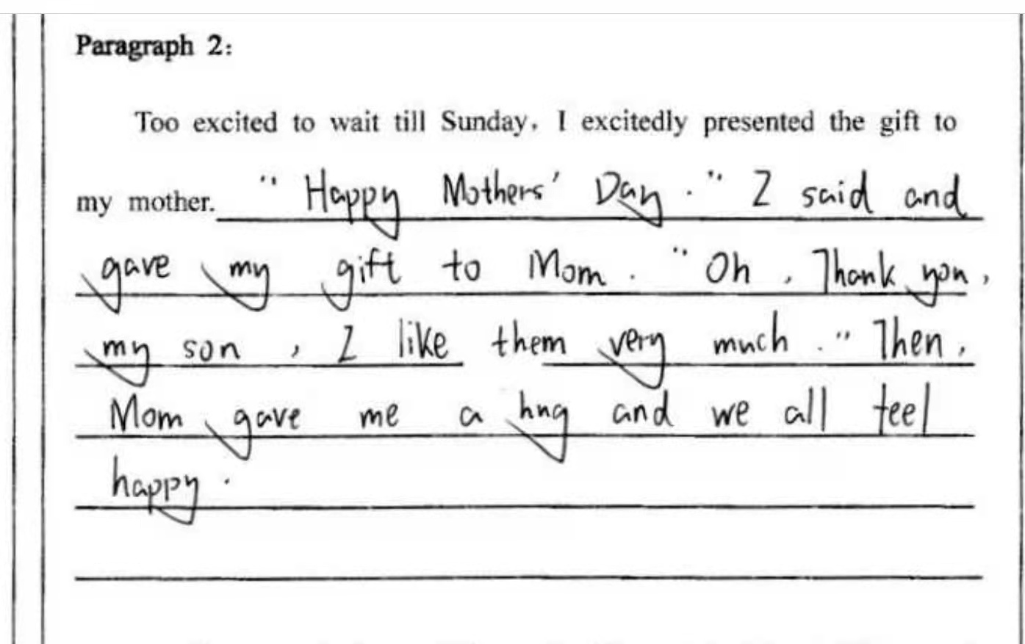
Lead -in:

Slide 4
Problems in continuation writing:
Too much exposition（叙述）
Lack of description（描写）

Slide 5
What is description?
丁往道等编著的《英语写作手册》 （2016）P116、P133中对于描写的定义为:Description is painting a picture in words of a person， place，object，or scene. A description essay is generally developed through sensory details， or the impressions of one's senses - sight， hearing， taste， smell， and touch. 即描写是通过对各个感官的 细节描述来刻画人、事与物。

Slide 6
Exposition（叙述） or description?
1. When Hassan was crying, I tried my best to comfort her.
2. Later, in the dark, after the movie had started, I heard Hassan next to me, sobbing. Tears were sliding down her checks. I reached across my seat, threw my arm around her, pulled her close.
exposition
description

Slide 7
Appreciation and imitation:
actions 动作的丰富性
feelings 情感表达的多样性
Not only “said”说的多样性
Nonfinite verbs as adverbial非谓语动词做状语

Slide 8
1.Appreciation:actions 动作的丰富性
Examples:
Instead of going by way of streets and sidewalks, they crossed empty lots, and climbed over fences.
At the same time, Mr. Henderson was watching their coming in the room with fascination and delight - always satisfying the boys by appearing at the last minute and scaring them.
Tip: 用丰富的动词来描述动作行为

Slide 9
Technique of description 1. 三连动（3verbs)
Examples:
He watched the boys as Auggie instructed, directed, and led the attack.
Auggie bounced around in the tree, hung from a branch, and then dropped to the ground.

Slide 10
Imitation:
Practice: She hid the gift for her mother.
Avoiding being seen by her mother, she ______(溜进) into her bedroom. Then, she ______(打开) the closet, ______(放)the gift on top of her clothes, and ______（覆盖） it with her big yellow straw hat.
Avoiding being seen by her mother, she sneaked into her bedroom. Then, she opened the closet, put the gift on top of her clothes, and covered it with her big yellow straw hat.

Slide 11
2.Appreciation:feelings情感表达的多样性
Example: The boys surrounded the tree cautiously. They hoped the apricots were ripe. But they were afraid, too. Afraid of Henderson, and guilt, and afraid the apricots weren’t ripe yet.
Practice: She was happy to have the gift in time.
She ___________（紧紧抓住）the gift________ （cautious） and felt like ______________（欢天喜地）. She _______（希望） her mother would be _________（惊喜）to see the gift. But she was ______, too. _____ that her mother would not like the gift.
She held on to the gift cautiously and felt like walking on air. She hoped her mother would be surprised to see the gift. But she was afraid, too. Afraid that her mother would not like the gift.
Tip: 用不同类别的词来表达情感

Slide 12
Technique of description 2. 主句+“with +n.”
Examples:
He cried with much pain.
Mr. Henderson was watching their coming in the room with fascination and delight.
While the gang watched with fascination, amazement, and admiration, Mr. Henderson stepped out of the house onto the back-porch steps with a hidden smile.

Slide 13
Imitation:
Practice: Mum opened the gift.
Mum looked at me with _______. She untied the gift with _____ and ________. When she saw what’s inside, she stand up to kiss me with __________________（眼里闪烁着泪花）.
升级版：主句+with+宾语+宾语补足语（with的复合结构）
Mum looked at me with surprise. She untied the gift with caution and delight. When she saw what’s inside, she stand up to kiss me with tears shining in her eyes.

Slide 14
3. Appreciation: not just “said”“说”的多样性
Examples:
"It’s wrong to steal, " Lionel said. "Not apricots, " Auggie shouted.
"Here they come. Slowly, now. Hah - hah, "he laughed.
"Are you going to climb the tree? "Nickie asked.
“Ouch! That hurts!” He cried with much pain.
“Sorry. We…, we won’t do that again.” Auggie stumbled, lowering his head.

Slide 15
Technique of description 3: use other words to replace “said”.
For example, you could replace “said’ with:
cried stumbled(结结巴巴地说）remarked laughed
exclaimed（惊呼） reported
commented whispered（耳语）
shouted sighed
screamed barked（咆哮）
murmured （嘀咕）yelled （大叫）
replied roared（吼叫）

Slide 16
Practice:
“Do you like it，do you like it？” I___________ excitedly.
“Yes, I love it so much and I’ll keep it with me，” ________my mother.
“But, how can we afford such expense?” she _______.
exclaimed
replied
sighed

Slide 17
4.Appreciation:
Nonfinite verbs as adverbial非谓语动词作状语
Examples:
He had been hiding outside some place, waiting to take the boys by surprise.
Auggie stumbled, lowing his head.

Slide 18
Imitation:
Technique of description 4:非谓语动词作状语“-ing /-ed/ to do ”
Practice:
1.I want to give Mum a surprise.
I hid the gift in the closet, ________（want）to give Mum a surprise.
2.Mum was delighted.
Mum was delighted, ________(smile) sweetly.
wanting
smiling

Slide 19
Practice:
3. ______________________________(被我的行为感动），Mum hugged me tightly.
4. ____________________________(为了不被妈妈看见）, she sneaked into her bedroom.
Moved by what I had done for her
Not to be seen by her mother,

Slide 20
Summary
1.动词三连（verb1+verb2+and verb3）
2. 主句+with复合结构
3.用其它词代替“said”
4.非谓语动词“-ing /-ed/ to do”

Slide 21
Have a try:
情节：我打算悄悄进门把礼物藏起来，结果却被妈妈发现。
Mum asked: “What are you doing, sweet heart? What’s that you are hiding ?”
______________________________________________________________________________________________________________________________________________________________________________________________

Slide 22
Mum asked: “What are you doing, sweet heart? What’s that you are hiding ?”
“……” I + 说（no ‘said’）
+表情
如with a panic /an expression of ...
+眼神
如looking at Mum nervously/with my eyes fixed to the floor
+低头
如kept my head down
+肢体
如trembled with a shaking hand/with my palm sweating
+心跳 如my heart beat wildly
“Oh,…It’s … It’s nothing…just my homework…”I stumbled with a panic, looking at Mum nervously. I managed to hide the gift behind my back with my palm sweating. My heart beat wildly. “I need to finish it as soon as possible…” I turned around, ran into my bedroom and closed the door quickly.

Slide 23
Assignment
Polish your writing
choose a person, a scene, a moment etc.
and create a detailed and vivid description
(looks, feelings, actions, surroundings… )

