Slide 1
Module 7 Unit 1 project Making a list of advantages and disadvantages

Slide 2
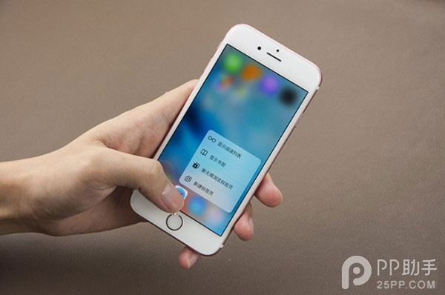
What can you do with a smart phone?

Slide 3
...from Hamlet?
To phone or not to phone?
Features(特点) of the title of a newspaper article?
Creative attractive
to be brief(简洁) interesting
to the point(切题)

Slide 4
To phone or not to phone?
Q: When you read the title, what do you think of?
If the writer is likely to lay emphasis on(强调)_____________, he will give examples about _________________________________.
to phone
the possible advantages of phones.
If the writer is likely to lay emphasis on(强调)_____________, he will give examples about _________________________________.
not to phone
the possible disadvantages of phones.

Slide 5
Reading
Read the first two paragraphs (Paras 1-2) and try to answer the following questions:
Which group of people are talked about?
2.What do you know about this group of people?
3.Why do they reject most modern technology?
The Amish in the USA.
A Christian group who are famous for having rejected most modern technology.
Because they don’t think it is necessary and they like having tight communities.

Slide 6
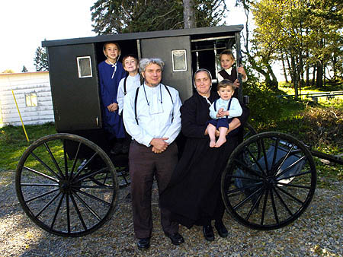
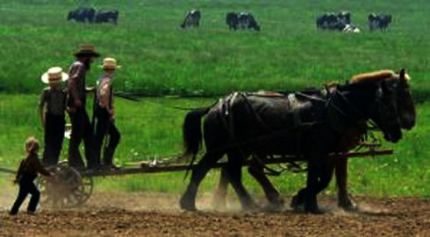
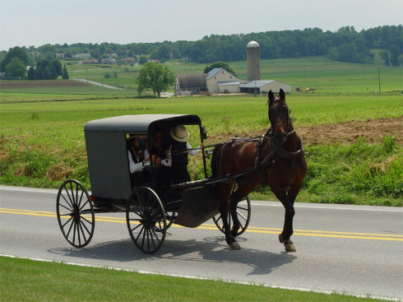

Slide 7
What’s the point in Para3?
However, maybe the Amish have a valid point. What does the valid point refer to?
Main point 1
There is something important about being together and sharing life that cannot be found over a telephone wire.
Supporting details
Which is more of a fiend, someone you often talk to over the phone or someone you often talk to face to face?
If you need help, who can help you better, someone far away or someone in the room with you?

Slide 8
What’s the point in Para 4-5?
Main point 2
The calls destroy _________one has or ________________________.
Supporting details:
No matter what the circumstances, when the phone
rings, everyone stops so that the call can be answered.
When the family are eating or chatting together
When one is absorbed in a book or tries to rest
when having a face to face talk with a friend
the peace
waste one’s precious time

Slide 9
What’s the point in Para 6?
Main point 3
Using the mobile phone for text messages is the worst.
Supporting details:
Relationships are nearly always quite shallow.

Slide 10
To phone or not to phone?
Main point 1
There is something important about being together
and sharing life that cannot be found over a
telephone wire.
Main point 2
The calls destroy the peace one has or waste one’s precious time.
Main point 3
Using the mobile phone for text messages is the worst.
According to the main points, what conclusion
can you draw?
Maybe the writer wants to encourage people to learn
from the Amish.

Slide 11
Reading
Read the last two paragraphs (paras 7-8) and answer the following questions:
What solution does the author offer?
Why does the author offer the solutions with “maybe”?
What is the tone of the last sentence? (what’s that? … sorry, I have to go. The phone’s ringing…)
Maybe we should throw all of our phones into the dustbin, along with our cars and TVs for good measure.
He is doubtful about those solutions.
A. Hopeful. B. Humorous. C. Depressed

Slide 12
Structure of the article
Part 1(Para 1-2): Brief ____________ of the Amish as well as their___________ towards telephones.
Part 2(Para 3-6): ______________ to phones based on their valid point.
Part 3(Para 7-8): ____________of the article---Possible__________ to the problem
introduction
attitudes
Disadvantages
Conclusion
solutions

Slide 13
Further reading
To phone or not to phone?
In the USA, the Amish－a Christian group--are famous because they drive carriages instead of cars,do not use TVs or refrigerators, and do not have personal telephones.
(1)__________, they oppose having telephones in their houses. However, in each community there is often a small building that has a telephone for emergencies.
The telephone is very convenient for communication, and most people in the world today cannot live without it.(2)__________.Which is more of a friend, someone you often talk to over the phone or someone you often talk to face to face?
(3)__________. For example, no matter what the circumstances, when the phone rings, everything stops so that the call can be answered.
(4)__________.In one study, girls average 80 text messages a day, and boys average 30.
Living a simple and primitive life, the Amish in general have a higher degree of mental health than most people.They have very calm and stable lives(5)__________.
A.which is completely right
B.However, maybe the Amish have a valid point
C.There are other disadvantages to the telephone, as well
D.Since the Amish value seeing each other face to face
E.because they value community and living in peace above all else, especially new technology
F.Of course, using the mobile phone for text messages is the worst
G.Because telephones are extremely expensive for them, and their homes do not have electricity

Slide 14
To phone or not to phone?
In the USA, the Amish－a Christian group--are famous because they drive carriages instead of cars,do not use TVs or refrigerators, and do not have personal telephones.
(1)__________, they oppose having telephones in their houses. However, in each community there is often a small building that has a telephone for emergencies.
A. which is completely right
B. However, maybe the Amish have a valid point
C. There are other disadvantages to the telephone, as well
D. Since the Amish value seeing each other face to face
E. because they value community and living in peace above
all else, especially new technology
F. Of course, using the mobile phone for text messages is the
worst
G. Because telephones are extremely expensive for them,
and their homes do not have electricity
D

Slide 15
To phone or not to phone?
The telephone is very convenient for communication, and most people in the world today cannot live without it. (2)__________.Which is more of a friend, someone you often talk to over the phone or someone you often talk to face to face?
(3)__________. For example, no matter what the circumstances, when the phone rings, everything stops so that the call can be answered.
A. which is completely right
B. However, maybe the Amish have a valid point
C. There are other disadvantages to the telephone, as well
D. Since the Amish value seeing each other face to face
E. because they value community and living in peace above
all else, especially new technology
F. Of course, using the mobile phone for text messages is the
worst
G. Because telephones are extremely expensive for them,
and their homes do not have electricity
B
C

Slide 16
To phone or not to phone?
(4)__________. In one study, girls average 80 text messages a day, and boys average 30.
Living a simple and primitive life, the Amish in general have a higher degree of mental health than most people.They have very calm and stable lives(5)__________.
A. which is completely right
B. However, maybe the Amish have a valid point
C. There are other disadvantages to the telephone, as well
D. Since the Amish value seeing each other face to face
E. because they value community and living in peace above
all else, especially new technology
F. Of course, using the mobile phone for text messages is the
worst
G. Because telephones are extremely expensive for them,
and their homes do not have electricity
F
E

Slide 17
Writing:
中学生校园是否能使用手机问题是中学生最热的话题之一，对此，有的同学说好，有的同学则持反对意见。请你根据下面所提供的信息写一篇短文，并提出你的可能的解决办法。 (150词左右）
优点 | 缺点
1. …； 2. …； 3. …。 | 1. …； 2. …； 3. …。

Slide 18
The structure of the passage:
Paragraph 1. Introduction-- introduce the problem
/topic.
Paragraph 2. Advantages of using mobile phones.
Paragraph 3. Disadvantages of using mobile phones.
Paragraph 4. Possible solutions ----- your suggestions.

Slide 19
Writing
Make a list of advantages and disadvantages of using mobile phones.
Advantages | Disadvantages
Help to get touch with sb in time.
Send text messages
Take photos
Surf the internet for information
In case of emergencies
Serve as a entertainment to relax
Listen to music
…
Add financial burden to parents;
Disturb study or work
Produce radiation
Influence physical health
Do harm to eyesight
Be lost in playing games
Spend long chatting through QQ/wechat
…

Slide 20
Writing
Writing:
中学生校园是否能使用手机问题是中学生最热的话题之一，对此，有的同学说好，有的同学则持反对意见。请你根据下面所提供的信息写一篇短文，并提出你的可能的解决办法。 (150词左右）
优点 | 缺点
1. …； 2. …； 3. …。 | 1. …； 2. …； 3. …。

Slide 21
Writing
It is a hot topic whether students can use mobile phones on the campus. There are two opposite opinions about it. Some students say “yes”, while others say “no”.
On the one hand, some students think mobile phones have a lot of advantages. Firstly, it is very convenient for them to get in touch with their parents and friends in case of emergency. Secondly, with the help of mobile phones, they can surf the Internet for information, which is beneficial to their study. Finally, to relieve the pressure of study, they can use mobile phones to relax themselves, such as listening to music, watching movies.

Slide 22
On the other hand, others hold the opposite opinion. Using mobile phones costs too much money, including the money to buy them with and the phone bill to pay, which will add financial burden to their parents. In addition, their studies will be affected if they play phones too much. Last but not least, it is harmful to their growth for them to send and receive bad text messages.
In a word, I think students can do without phones on the campus. They can’t be disturbed by the ringing and the text messages from the phone. What’s more, they can’t waste their precious time chatting over the phone.

Slide 23
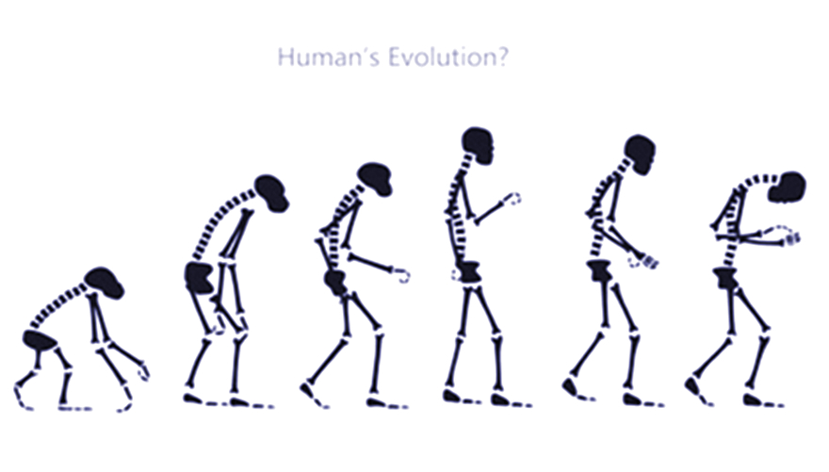
Phubbers(低头族) refers to the people who can’t help checking their phones all day.

Slide 24
Homework
Polish up the short passage.
Review the passage and underline important phrases.

Slide 25
Thank you!

