Slide 1
M1 U4 Reading (1)
Looking good, feeling good
Xi Zhimei

Slide 2
Step 1 Fast-reading
Ⅰ.Read the passage quickly and fill in the following blanks with suitable words.

Slide 3
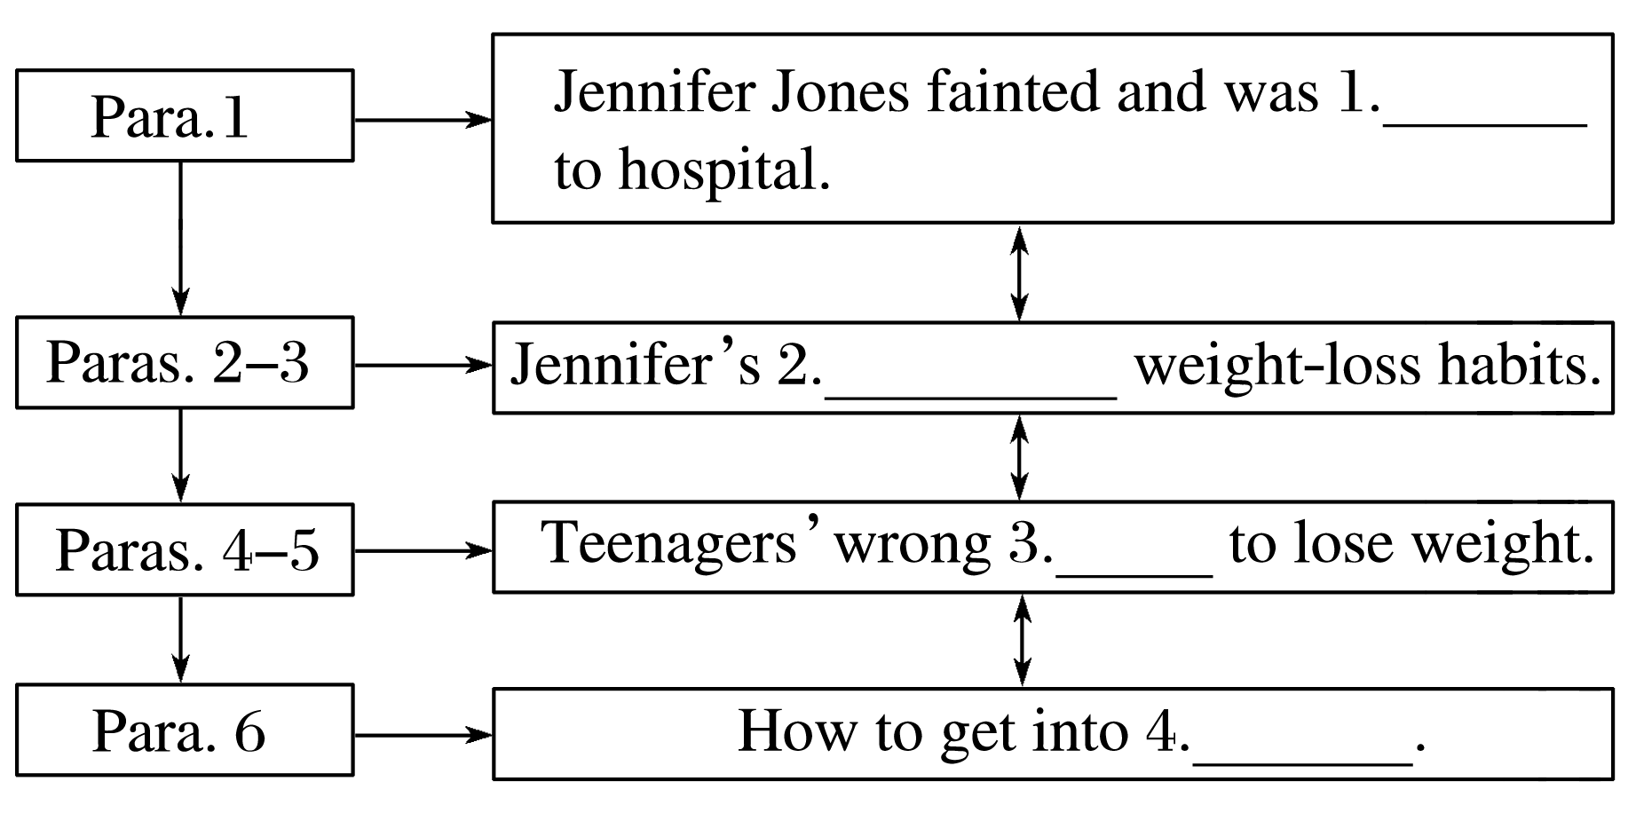
rushed
unhealthy
ways
shape

Slide 4
Ⅱ.The main idea of the passage is teenagers’ .
unhealthy weight-loss habits

Slide 5
Step 2 Careful-reading
Read the passage carefully and choose the best answer.
1.We can learn from Jennifer’s case that .
A.some teenagers are eager to become slimmer
B.some teenagers don’t like breakfast
C.some parents ignore their children
D.some teachers don’t warn their students
√

Slide 6
2.Which of the following statements is TRUE?
A.Jennifer doesn’t work very hard.
B.Jennifer’s friend warned her of her bad eating habits.
C.About one tenth of teenagers regularly skip meals.
D.Teenagers shouldn’t do plenty of exercise.
√

Slide 7
3.Some wrong methods are mentioned EXCEPT in the fourth paragraph.
A.skipping meals
B.over-exercise
C.drinking too much water
D.eating weight-loss pills
√

Slide 8
4.Health authorities are trying to educate teens about .
A.the side effects of eating too little
B.the side effects of eating too much
C.the side effects of losing weight too quickly
D.the side effects of losing weight too slowly
√

Slide 9
5.We can infer from the passage that .
A.teens should have a healthy balanced diet first
B.parents should prepare delicious breakfasts for their children
C.it’s dangerous for teens to be slightly overweight
D.health authorities should help teens lose weight
√

Slide 10
Step 3 Post-reading
Ⅰ.After reading the passage，please fill in the following blanks.
A teenage girl named Jennifer Jones fainted in her PE lesson and 1.___________(rush) to hospital.Jennifer was treated immediately and her parents told the doctor that their daughter had missed breakfast that day.Fortunately，Jennifer’s doctor said that she would make a full 2._______ (recover) soon.Jennifer’s classmates said that she had struggled with eating problems for a long time，for she thought 3. (skip) meals was a simple way to lose weight.
was rushed
recovery
skipping

Slide 11
Jennifer’s case is a reminder of the dangers of the unhealthy weight-loss habits 4. have become common among teenagers.A recent survey shows that some teenagers lose weight 5. (use) some extreme methods，such 6. skipping meals and eating weight-loss pills.7. expert said that it was normal for teenagers to be 8. (slight) overweight and there is no reason why they should be worried.She adds，“It is important to have a healthy balanced diet since teenagers are still growing and their bodies need a lot of nutrition 9. (function)well.What’s more，they should keep regular hours and get plenty of exercise to stay 10. (energy) and fit.Living well is the safest and most effective way to get into shape.”
that/which
using
as
An
slightly
to function
energetic

Slide 12
Ⅱ.Discuss with your partner and then answer the following questions.
1.Do you like slimmer figure？Why?
_______________________________________________
2.Have you formed a healthy diet and regular exercise？Please tell us about your habits.
________________________________________________

Slide 13
Step 4 Sentence-learning
1.I warned her that skipping meals was unhealthy，but she wouldn’t listen.
[句式分析] 本句为 连接的并列句。第一个分句中that引导 从句。
[自主翻译] ___________________________________________
2.In a society where being thin is often seen as being beautiful，teenagers sometimes turn to extreme methods to slim down quickly.
[句式分析] 本句为复合句。where引导 从句，修饰a society；主句中不定式to slim down quickly作 状语。
[自主翻译] _______________________________________________________
______
but
宾语
我警告过她不吃饭是不利于健康的，但是她不听。
定语
目的
在一个以瘦为美的社会里，青少年有时会借助极端的方法来快速减肥。

Slide 14
3.However，for those who are dangerously overweight，it is very important that they try to lose weight properly.
[句式分析] 本句是复合句。 引导定语从句，修饰those； 引导主语从句； 是形式主语。
[自主翻译] _______________________________________________________
who
that
it
然而，对于那些很危险的超重者，努力适当地减肥是很重要的。

Slide 15
4.We strongly encourage all teenagers to follow these lifestyle tips，because living well is the safest and most effective way to get into shape.
[句式分析] 本句是复合句。 引导原因状语从句。从句中的主语是由 _______充当的。
[自主翻译] _______________________________________________________
____________________________________
because
动名词
我们强烈建议所有青少年遵循这些生活方式的提示，因为活得好就是强身健体最安全和最有效的方式。
返 回

Slide 16
Step 4 Homework
1. Finish B2 on Page 47.
2. Finish Part A on Pages 77–78 with your partner.

