Slide 2
To read two news stories about plastic surgery
To Express your opinion about plastic surgery
To listen to the report and do some exercises

Slide 3
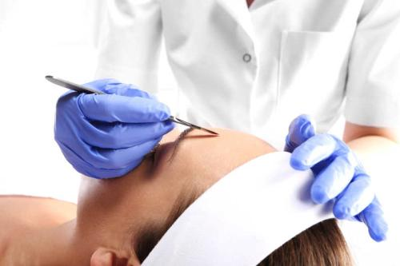
What is the doctor doing?
The doctor is doing facial
plastic surgery on a lady.

Slide 4
plastic n. 塑料，塑胶
adj. 塑料的；人造的，不自然的
surgery n. 外科手术
plastic surgery: the medical practice of changing the appearance of people’s faces or bodies, either to improve their appearance or to repair injuries 整形外科，整容手术

Slide 5
Read two news stories on page 50 and answer the following questions.
1. How did the plastic surgery help Mr Wilson?
It repaired some of his burnt skin and made him feel more confident about his appearance.
2. What problems did the plastic surgery bring to Miss Edwards?
She couldn’t return to a normal life and suffered from daily pain, looked unnatural and was unable to make certain facial expressions.

Slide 6
短语
1.接受整形手术
2.致力于；改善
3.处于(某种困境)
4.容忍
5. 对……自信
6. 对……满意
receive plastic surgery
work on
be caught in...
live with sth
be confident about
be happy/pleased with
7. 发生
8. 受……折磨
9. 回归正常生活
10. 此外
11. 结果是
take place
suffer from
return to a normal life
in addition
turn out

Slide 7
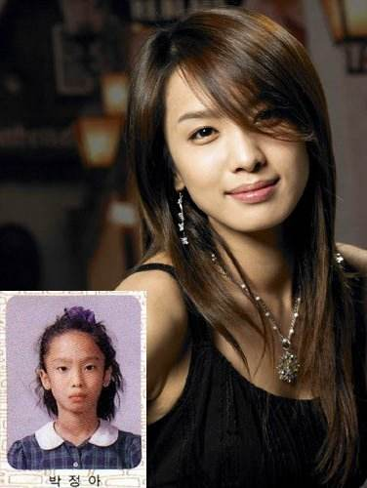
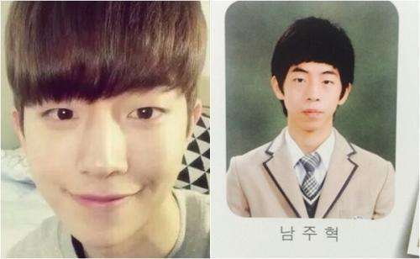
Before and after the plastic surgery

Slide 8
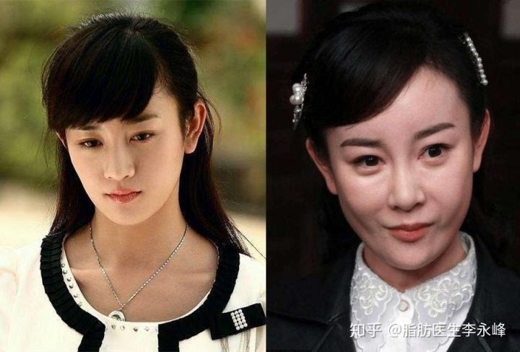
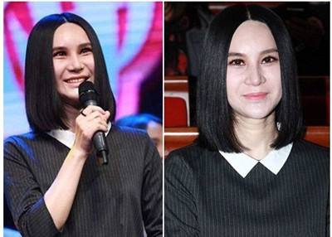
Before and after the plastic surgery

Slide 9
Discussion
Do you think it is necessary for one to receive plastic surgery? Why?

Slide 10
Alice, a news reporter, is reporting on plastic surgery. Listen and finish the exercises below.
Listen to the report and decide whether the following statements are true (T) or false (F). If the information is not mentioned in the report, just circle NG (not given).

Slide 11
1. The plastic surgery industry is very popular now. T / F / NG
2. These days, the number of men who have plastic surgery is almost the same as that of women. T / F / NG
3. Most actresses have had plastic surgery on their faces. T / F / NG

Slide 12
4. One of the advantages of plastic surgery is that it can treat burn marks. T / F / NG
5. Plastic surgery patients may suffer from terrible pain. T / F / NG
6. People under 18 should never have plastic surgery. T / F / NG

Slide 13
Listen to the report again and complete the notes below.
Plastic surgery
Results of recent research on plastic surgery
About (1) _____________ of all patients are men.
The average age of patients is (2) ___________________.
Experts believe the industry will (3) ________________ in the future.
appearance
one third
falling
continue to grow

Slide 14
• Advantages of plastic surgery
It is the easiest way to help people improve their(4) _________________.
It helps people
(5) ___________________________.
appearance
appearance
build their self-condidence

Slide 15
• Disadvantages of plastic surgery
It is very (6) ___________________.
It carries serious (7) ___________________. Patients may (8) ___________________ after failed plastic surgery operations or even die during operations.
The results of plastic surgery might be different from what people expect. This is especially true for (9) ____________.
expensive
health risks
suffer health problems
teenagers

Slide 16
What’s your opinion about plastic surgery? Write a short passage to show your ideas.

