Slide 1
教学目标
查找阅读题目问题之所在
厘清不同阅读题型的解题思路
（细节,推断与主旨）
体会完型中的明示与暗示
(上下文提示）
树立满分信念

Slide 2
阅
读
理
解
阅读完形词汇自查
constantly
casually
merely
restriction
consequence
comfort zone
bottom line
detect
suspicion
transformative
register
evaluate
consult
extend
composition

Slide 3
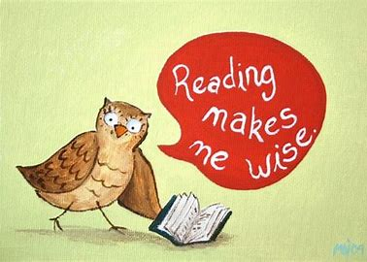
阅读理解题型与思路
1
Part

Slide 4
阅
读
理
解
阅读错误题型一览
题号 | 正确率 | 考查类型 | 错因
30 | 73% | 细节理解 | ?
33 | 76% | 细节理解 | ?
35 | 78% | 主旨归纳 | ?
24 | 67% | 推理判断 | ?

Slide 5
一、细节理解
C---30
阅
读
理
解
审题
someone trying race walking
…consult a coach or experienced racer to learn proper technique
定位
比对
A. getting experts’opinion
C. hiring an experienced coach
结论

Slide 6
一、细节理解
D---33
阅
读
理
解
审题
sensors printed on leaves
B. to change compositions of plants
The engineers at the MIT have taken it a step further -----changing the actual composition of plants in order to get them to perform diverse，even unusual functions. These include plants that have sensors printed onto their leaves to show when they’re short of water and a plant that can detect harmful chemicals in groundwater.
定位
比对
A. to detect plants’lack of water
结论

Slide 7
二、主旨归纳
D---35
阅
读
理
解
topic
main idea of each paragraph
the structure of the pasage

Slide 8
二、主旨归纳
Para 1
阅
读
理
解
The connection between people and plants has long been the subject of scientific research. Recent studies have found positive effects. A study conducted in Youngstown，Ohio，for example, discovered that greener areas of the city experienced less crime. In another,employees were shown to be 15% more productive when their workplaces were decorated with houseplants.
Positive effects of plants on people

Slide 9
二、主旨归纳
Para 2
阅
读
理
解
The engineers at MIT have taken it a step further ---changing the actual composition of plants in order to get them to perform diverse,even unusual functions. These include plants that have sensors printed onto their leaves to show when they’re short of water and a plant that can detect harmful chemicals in groundwater. ＂We’re thinking about how we can engineer plants to replace functions of the things that we use every day,＂explained Michael Strano, a professor of chemical engineering at MIT.
MIT’s new technology---unusual functions

Slide 10
二、主旨归纳
Para 3
阅
读
理
解
One of his latest projects has been to make plants grow（发光）in experiments using some common vegetables. Strano’s team found that they could create a faint light for three-and-a-half hours. The light，about one-thousandth of the amount needed to read by，is just a start. The technology, Strano said, could one day be used to light the rooms or even to turn tree into self-powered street lamps.
MIT’s glowing plants—turn trees into lamps

Slide 11
二、主旨归纳
Para 4
阅
读
理
解
In the future，the team hopes to develop a version of the technology that can be sprayed onto plant leaves in a one-off treatment that would last the plant’s lifetime. The engineers are also trying to develop an on and off＂switch＂where the glow would fade when exposed to daylight.
MIT’s new version of the technology
----more convenient /flexible

Slide 12
二、主旨归纳
Para 5
阅
读
理
解
Lighting accounts for about 7% of the total electricity consumed in the US. Since lighting is often far removed from the power source（电源）—such as the distance from a power plant to street lamps on a remote highway---a lot of energy is lost during transmission（传输）.
Glowing plants could reduce this distance and therefore help save energy.
Benefit of glowing plants for lighting

Slide 13
二、主旨归纳
D---35
阅
读
理
解
para1
positive effects of plants on people
para2
MIT---change the composition of plants
---unusual function
para3
MIT---glowing plants
---turn trees into lamps
para4
MIT---develop a version of the technology
---convenient& flexible
para5
benefits of glowing plants for lights

Slide 14
二、主旨归纳
D---35
阅
读
理
解
Could glowing plants replace lamps?
We are thinking about how we can engineer plants to replace functions of the thngs we use everyday.
para2
The technology could one day be used to light the rooms or even to turn trees into self-powered lamps
para3
para4
The team hopes to develop a version of the technology … The engineers are also trying to develop …

Slide 15
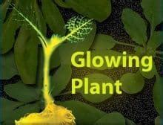
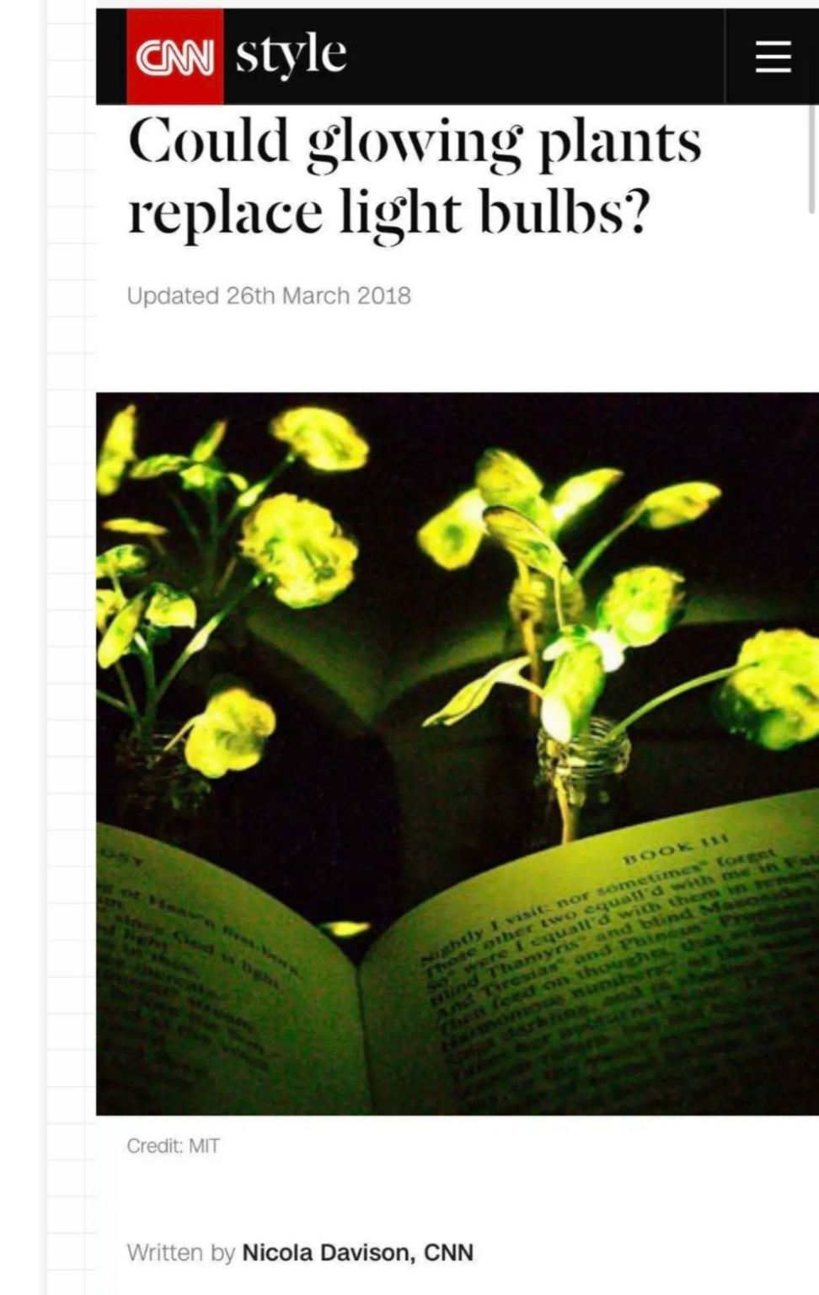
二、主旨归纳
D---35
阅
读
理
解

Slide 16
三、推理判断
B---24
阅
读
理
解
Returning to a book you’ve read many times can feel like drinks with an old friend. There’s a welcome familiarity — but also sometimes a slight suspicion that time has changed you both, and thus the relationship. But books don’t change, people do. And that’s what makes the act of rereading so rich and transformative.
审题
定位
信息整合
字里行间
people change.
结论

Slide 17
三、推理判断
B---24
阅
读
理
解
Now you are different from past
The beauty of rereading lies in the idea that our bond with the work is based on our present mental register. It’s true, the older I get, the more I feel time has wings. But with reading, it’s all about the present. It’s about the now and what one contributes to the now, because reading is a give and take between author and reader. Each has to pull their own weight.
A. It evaluates the writer-reader relationship
D. It extends the understanding of oneself
审题
定位
信息整合
字里行间
结论

Slide 18
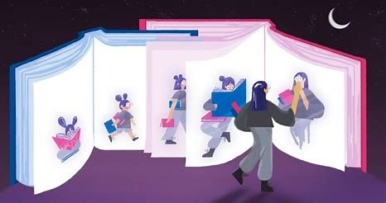
It’s not that the old books are getting better, but that we all have stories.

Slide 19
阅
读
理
解
阅读错误题型一览
题号 | 正确率 | 考查类型 | 错因
30 | 73% | 细节理解 | 比对
33 | 76% | 细节理解 | 定位
35 | 78% | 主旨归纳 | 主题词
24 | 67% | 推理判断 | 定位、理解
Different problems need different ways to solve , but the bottom line is: you should know take it seriously

Slide 20
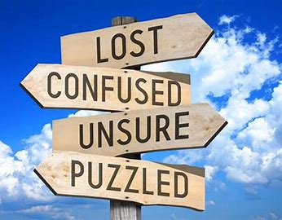
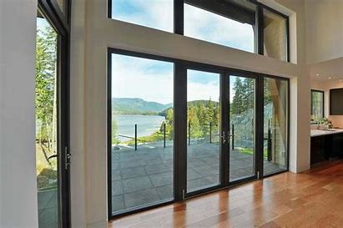
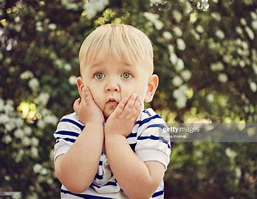
完形填空的明示与暗示
Part

Slide 21
完
形
填
空
完形错题一览
43 | 76%
45 | 73%
46 | 65%
50 | 78%
53 | 69%
58 | 73%
59 | 71%

Slide 22
完
形
填
空
To lie or to tell the truth, that’s a question.
A door or a window, that’s a question..
Since our twins began learning to walk, my wife and I have kept telling them that our sliding glass door is just a window. The reason is obvious. If we admit it is a door, they’ll want to go outside 43 . It will drive us crazy. The kids apparently know the truth. But our insisting it’s 45 a window has kept them from 46 millions of requests to open the door.

Slide 23
完
形
填
空
The reason is obvious. If we admit it is adoor, they’ll want to go outside 43 . It will drive us crazy...
I wonder if parents should always tell the truth no matter the 50 . I have a very strong fear that the lie we’re telling is doing spiritual damage to our children. Windows and doors have 53 metaphorical（比喻） meanings. I’m telling them they can’t open what they absolutely know is a door. What if later in life they come to a metaphorical door, like an opportunity（机会） of some sort…..

Slide 24
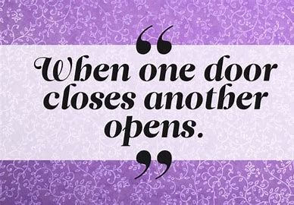
It’s up to you to find it.

Slide 25
The reason is obvious. If we admit it is adoor, they’ll want to go outside 43 . It will drive us crazy...
完
形
填
空
Maybe it’s an unreasonable fear. But the 58 is that I shouldn’t lie to my kids. I should just 59 repeatedly having to say, ＂No. We can’t go outside now.＂ Then when they come to other doors in life, be they real or metaphorical, they won’t hesitate to open them and walk through.

Slide 26
完
形
填
空
善于发现逻辑与关联
43 | 76% | constantly
45 | 73% | merely
46 | 65% | attempt
50 | 78% | consequences
53 | 69% | important
58 | 73% | bottom line
59 | 71% | accept

Slide 27
Everyone wants to be like Yu Ziran. The bottom line is that you're willing to step out of your comfort zone, challenging yourself and pushing yourself work harder. Please read and reread until you make it!!

Slide 29
阅
读
理
解
---the lowest price that sb will accept
---the most important thing that you have to
•The bottom line is :
You're living your life and you make it either happy or sad.

