Slide 1
U 2 Project
Making a speech about sport

Slide 2
Learning aims
understand the general meaning of the two passages by doing some exercises
know how to make a speech about Wushu and what is the most important thing in competition
can develop the quality of being honest and confident

Slide 3
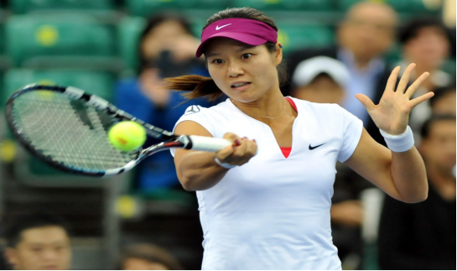
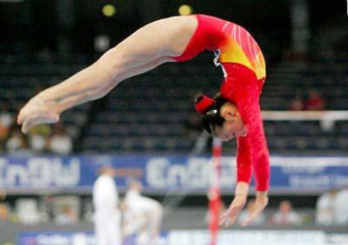
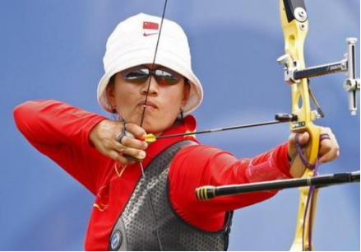
Lead-in
Can you name
the following
sports?
table tennis
archery
gymnastics

Slide 4
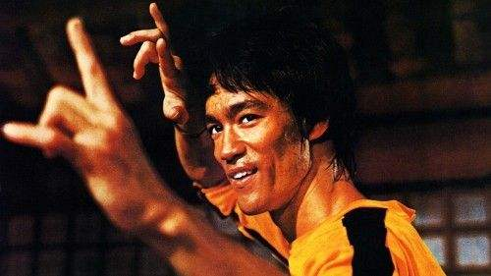
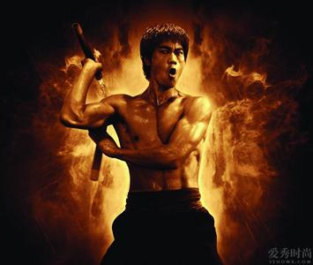
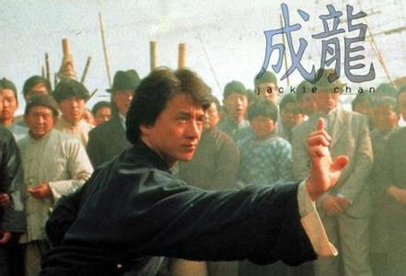
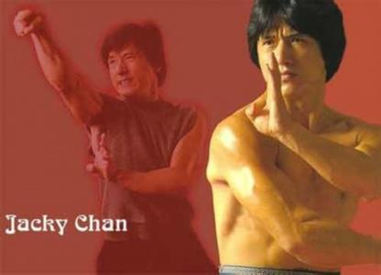
Thinking
Are there any similarities
between them?

Slide 5
Thinking
Wushu
The Olympics

Slide 6
Reading
Part 1
What requirements must be met before a sport can be considered by the IOC?
1.A sport must have its own international association.
2. A sport should be practiced by
3.The existed sport must be dropped.
men in at least 75 countries on at least four continents.
women in at least 40 countries on three continents
Notes:
6
跟读第一段解决上述问题

Slide 7
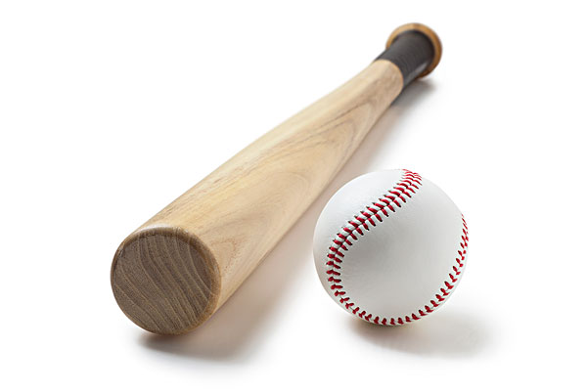
Reading
Part 2
What sports have been removed from the Olympics? Why?
baseball
power boating
Because these sports became less popular and had to make way for new, more popular sports.
Notes:
7
听课文完成问题

Slide 8
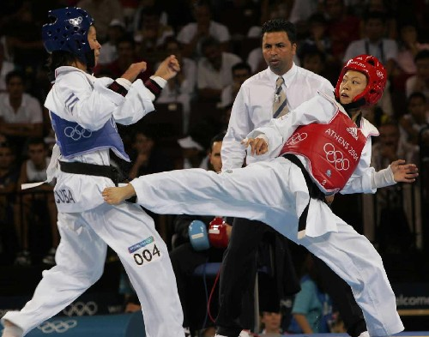
Reading
Part 3
1.What sports have been added in the Olympics only recently? In which year?
Tao kwon do, in 2000.
2. What other sports will probably be included? Why?
Rugby and golf. Because they are now very popular and are played all over the world.
Notes:
8
跟读课文，完成问题

Slide 9
Reading
Part 4
1.Why hasn’t Wushu become an Olympic event?
it is full of danger
many relative sports have existed, such as boxing
few of people know Wushu
2. Will Wushu be added in the Olympic sport in the future?
Yes, because the IOC is considering changing
the number and type of Olympics

Slide 10
summary
1. to be met | Having its own international 2._________.
 | Being 3._________by men in at least 75 countries on four 4._________.
 | 5._________a current sport to keep the Olympics under 6. _________.
Present 7._________ of sports | Some have been 8._________ from the Olympics.
 | Some have been 9.________ only recently.
 | Others are still trying to get into the Olympics.
In short, it can be a long 10._________.
association
practiced
Requirements
continents
Dropping
control
removed
situation
added
process

Slide 11
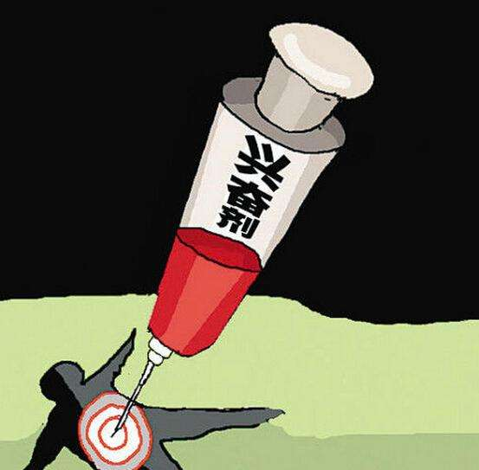
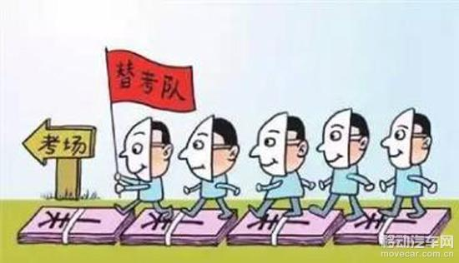
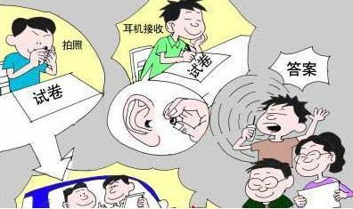
Passage two
Winning isn’t everything, and is more important.
Winning isn’t everything.
Is winning important?

Slide 12
Multiple-choice
1. How many teams are mentioned in this passage?
Two. B. Three. C. Four. D. Five.
2. What can we know from the writer’s words “the goal should not have counted”? (line 6)
A. The writer didn’t like the referee.
B. The writer wasn’t satisfied with what the Eagle’s captain did.
C. The goal was not counted according to the referee.
D. The Kangaroos won the first match at last.

Slide 13
3. Which of the following statements can’t show the writer’s aim of the passage?
A. Being honest is the best policy.
B. Friendship must come first.
C. All is well that ends well.
D. Do well and have well.

Slide 14
4. What can we infer from the tournament between the Kangaroos and the Bears?
A. The Kangaroos’ captain lost the game but was honest.
B. The Kangaroos’ captain stopped the match because he broke the rule.
C. The Bears won but lost their friendship, honour and respect.
D. Both the two teams were not friendly to each other.

Slide 15
Detailed reading
Which team is the real winner:
the Kangaroos, the Eagles, or the Bears？

Slide 16
Group work
MAKE A SPEECH

Slide 17
Group work
Choose one of the following topics:
Introduce Wushu to the IOC members
Winning isn't everything, what is more important?( honest, friendship, process ,and so on)

Slide 18
How to make a speech
The outline of a speech:
Great the audience
Beginning
Express thanks
Introduce your subject
Body
Supporting details of your subject
Ending
Sum up your idea

Slide 19
Some useful expressions :
Good morning, ladies and gentlemen:
I am delighted to have been invited to ….to…..
It’s my great honor to give a speech here.
Thank you so much.
Thank you for taking the time to listen to my speech.
Thank you for your kind attention.
Thanks again for coming.

Slide 20
Show Time
Be confident

Slide 21
Sample
The Charm of Wushu
Good Afternoon, ladies and gentlemen. I am delighted to be here to nake a speech with you. Today, my topic is the charm(魅力）of Wushu.
As we all know, with the development of china’s economy, more and more centuries realize that china plays an important role in the international areas. So, Wushu, a classic sport, has been known by people all around the world. now, I want to tell you some advantages of Wushu. Firstly, it can strengthen your body and improve your mind. What’s more , it is full of beauty. Practicing Wushu can shape your figure.
In brief, I hope you can take my advice. Thank you.

Slide 22
My Opinion about Winning
Hello, everyone. I’m glad to have the chance to share with you my opinion about winning. I think winning isn’t everything, and the most important thing is the process.
People must come across plenty of troubles when they're trying to do something. They spare no effort to reach their goals but sometimes fail. But life does not mean nothing at all. At least they have tried. In my opinion, the process is much more important than winning. The process is made up of hard work, experience you have collected, and courage. You should be aware of these and speak highly of what you’ve been through. They are great treasures! So I think if you have tried very hard, that's enough. That’s all. Thank you.

