Slide 1
Welcome
to
our class!

Slide 2
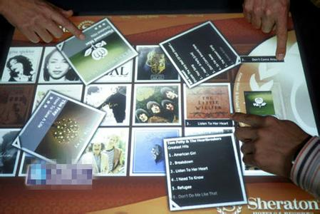
Now we're again experiencing a revolution which changes our life a lot

Slide 3
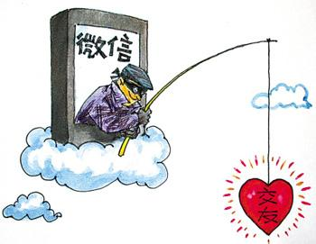
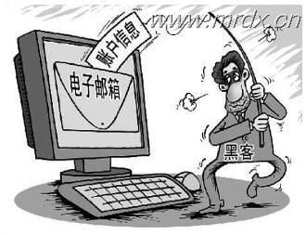

Slide 4
Do you think it's legal or illegal?
we call this criminal offence related to the internet cybercrime.

Slide 5
Unit 4 Law and order
connected with Internet
Fight against cybercrime
cyber

Slide 6
Learning Aims
By the end of this lesson, we will be able to
gain information about cybercrime by scanning and skimming the text;
understand the definitions of difficult vocabulary through the context;
write an article to raise people’s awareness of preventing cybercrime.

Slide 7
Read for structure
opic
Part 1 (Para.1)
The t____ of the speech
D_______ and c________ of cybercrime
Part 2 (Para.2)
efinition ategories
roblems
The severe p_______ of
cybercrime and the r______
for cybercriminals
impossible to catch.
Part 3 (Paras.3-6)
easons
Part 4 (Paras.7-8)
The s_______ to cybercrime
olutions

Slide 8
Reading for details (para.2)
What is cybercrime?
How many categories of cybercrime are
there and what are they ?

Slide 9
Read for details (para.2)
means/is…
What is cybercrime?
Cybercrime refers to any criminal offence related to the Internet.
Intellectual Property?
(It is a design, patent, book, film, ect., that the law prevents others people from copying)
Where do the definitions of difficult vocabulary appear
The definition appears after the first use of
the word or phrase.
2. The definition appears in “(…………)”.
3. Normally, it appears after”,”.
reading strategy

Slide 10
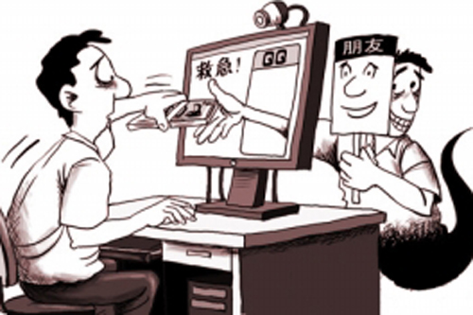
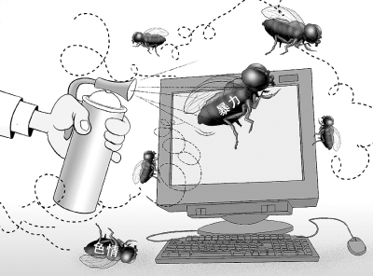
Read for details (para.2)
How many categories of cybercrime are
there and what are they ?
③website contents;
① security;
④ intellectual property.
② occur over the internet without computers;
① security;
② occur over
the Internet
without
computers;
③ website
contents;
④ intellectual
property.
① related to security;
② crimes occur over the Internet without
computers;
③related to website contents;
④ related to intellectual property.

Slide 11
Read for details (paras.3-6)
Cybercrime
Problems
of cybercrime
Reasons for cybercriminals difficult to catch
★ Cheating people
of money, spreading
viruses and hacking.
★Cybercrime not
reported: fearing
that they will lose
customers.
★ Stealing money from
companies and
databases or
customers secrets
stolen
★Relevant laws
haven’t yet been
passed against it.

Slide 12
Read for details (paras.7-8)
Problems
of cybercrime
Reasons for cybercriminals difficult to catch
Solutions
★ International
cooperation
★ Cheating
people of
money
★Cybercrime
not reported
★ Making new
laws
★ Creating
international
standards
★ Stealing
money and
databases
or customers
secrets stolen
★Relevant laws
haven’t yet
been passed
against it.

Slide 13
Read for critical thinking
As students, what can you do to ensure cybersecurity?
★ Obey the laws on the Internet
★ Update anti-virus software
★ Don’t spread computer viruses
★ Don’t download films and music
from the Internet without permission
★ Don’t buy pirated（盗版）products

Slide 14
书面表达：
随着因特网的发展与普及，网络犯罪已逐渐渗透到人们生活的方方面面。请针对这个问题用英语写一篇150词左右的短文。
1、 网络犯罪日益猖獗的原因（至少两点）。
2、如何打击网络犯罪现象？谈谈你的想法。
With the development and widespread of the Internet in recent years, cybercrime has also found its way into people’s everyday life. This is really worrying。

Slide 15
1、 网络犯罪日益猖獗的原因（至少两点）。
topic sentence:
_______________________________________________
要有连接词
1）first, second, third, last
2）firstly, secondly, thirdly, finally
3） in the first place, in the second
place, in the third place, lastly
4） to begin with, then, furthermore, finally
(refer to your textbook Para.3-6 )

Slide 16
要有连接词
5）to start with, next, in addition, finally 6）first and foremost, besides, last but not least 7）most important of all, moreover, finally 8）on the one hand, on the other hand 9）for one thing, for another thing

Slide 17
2、如何打击网络犯罪现象？谈谈你的想法。
topic sentence:
_______________________________________________
Personally, ____________________________________
(refer to your textbook Para.7-8 )

Slide 18
3, concluding sentence or paragraph
All in all, only when __________________________________(总结观点）
I am looking forward to ______________（表达愿望）
Personally, I am convinced that it is high time we should___________________________ （发出号召）
When it comes to ~~, we are supposed to _________________________________（提出建议）
……………………
In conclusion, _____________________
To conclude, ______________________

Slide 19
Cybercrime is becoming more and more serious for a number of reasons. Firstly, cybercriminals are usually computer experts who have a good knowledge of computer. The police are having trouble in keeping up with them. Secondly, cybercrime can take many shapes and occur nearly anytime anywhere. Criminals can move quickly, which makes it more difficult to spot, follow and catch them.
Steps must be taken to fight against cybercrime. Personally, education will be the solution to this problem. Let people know the threat of cybercrime and there will be fewer such crimes. Next, work together, whether individuals or states. This is the key to dealing with cybercrime. Also, making laws allows states to punish such criminals within and across borders.
To conclude, all of us must work together to stop the widespread problem of cybercrime.

Slide 20
Homework
1. Polish up your writing.
2. Re-read the speech and underline useful phrases or sentences.

Slide 21
Thank you !
Bye!

